Slide 1
Warm Up 9/3/2020
September 5th is “National Cheese Pizza Day.” What is your favorite type of pizza? Explain to someone how they would make your favorite type of pizza.

Slide 2
Join me over in Nearpod
View the class posts and click on the link for Nearpod.
Another browser will open, go ahead and log in and answer the 1st question.
Then wait for the rest of the class to join you there.
If you experience problems with the link, simply open a browser and pull up Nearpod.com
Code→ DIUNK

Slide 3
WHAT’S NEW IN SCIENCE?
DCI: Disciplinary Core Ideas
SEP: Science and Engineering Practices
CCC: Cross-Cutting Concepts
Phenomena
Houghton, Mifflin, Harcourt textbook
State Assessment

Slide 4
Disciplinary core idea
Disciplinary Core Ideas (DCI) are explanations of what you will be learning in a particular unit.
Ex. 7.PS1.1 Develop and use models to illustrate the structure of atoms, including the subatomic particles with their relative positions and charges.

Slide 5
Science and Engineering Practices
Science and Engineering Practices (SEPs) are what you will do to learn science content.
Asking Questions and Defining Problems
Developing and Using Models
Planning and Carrying Out Investigations
Analyzing and Interpreting Data
Using mathematics and computational thinking
Constructing Explanations and Designing Solutions
Engaging in Argument from Evidence
Obtaining, Evaluating, and Communicating Information

Slide 6
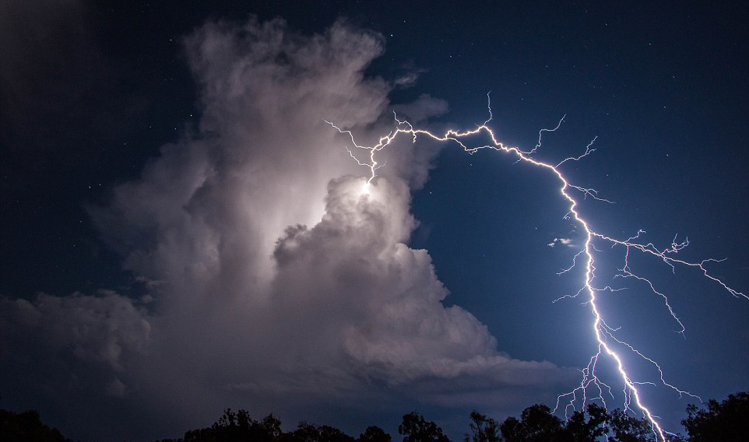
What is a Phenomenon?
Phenomenon is a fact or situation that is observed to exist or happen, especially one whose cause or explanation is in question.
Notes:
Ask the students: Why is this picture a phenomenon? Possible Answers: Lightning is coming out of the top of the cloud. Lightning goes up first.

Slide 7
Phenomenon: Why does the ketchup packet sink when the bottle is squeezed?
https://www.youtube.com/watch?v=OM6iC6N12xY
Notes:
After the video it is important to not give information to the students when they ask, “How does that happen?”

Slide 8
SEP 1: Asking Questions
Directions: Explore the bottle with the ketchup packet to see what it does. After a few minutes of exploration, write down questions that you have about what you see.
Notes:
It is important that the students understand how they are being graded and an example of questions that will not provide them with a high score. I ask my students, “why is, “How much is the ketchup packet?”, not a good question to ask. In the rubric to get an “A” all questions must add to your current understanding and to gain more information to solve the problem.

Slide 9
science Closure 09/03/2020
Which of the following are examples of Science & engineering practices?
Asking Questions
Engaging in argument from evidence
Using mathematics and computational thinking
All of the above

