Slide 1
Homeroom Warm Up
If you could end any one problem in the world, what would it be? Why?

Slide 2
Science Warm Up 11/6/2020
What type of substance is always made up of a single type of atom?
mixture
element
molecule
compound

Slide 3
Agenda
Warm Up
Notes on Pure Substances & Mixtures
Video * time permits
Give Test Retake Codes out (Due by 10PM)
Closure

Slide 4
Note the differences
Molecules of the same element
Note the similarities
SWBAT compare and contrast elemental molecules and compound molecules IOT classify matter as pure substances or mixtures based on composition.
Substances made up of 1 type of particles
Contains a variety of elements and compounds that are not chemically combined
Arrange in categories
Molecules of multiple elements
What something is made up of

Slide 5
PURE SUBSTANCES
Compositions are definite (they never change). They can either be an element, molecule or compound.

Slide 6
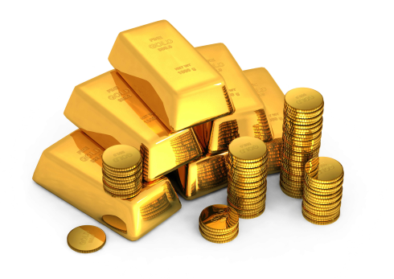
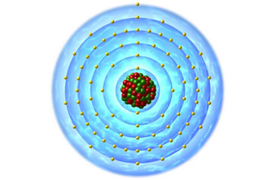
Atoms
Pure Substance
The smallest unit of matter.
Made up of protons, neutrons and electrons.
Keeps it’s physical and chemical properties.
For example, one ATOM of gold would still have the properties of gold. (malleable, lustrous, etc.…)

Slide 7
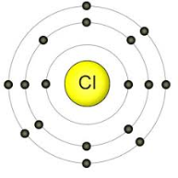
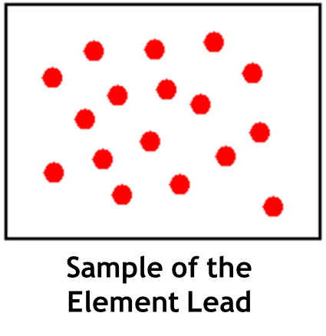
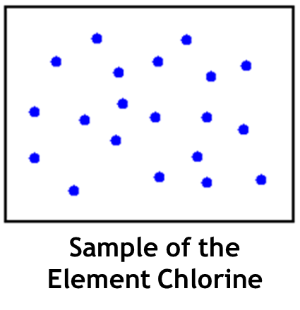
Elements
Pure Substance
Elements are made of one type of atom.
Cannot be broken down into simpler substances.
Found on the periodic table.
Example: Chlorine, Lead, Gold

Slide 8
Elements Combine in Chemical Reactions to Form Molecules
Oxygen and Hydrogen bond together to form water.

Slide 9
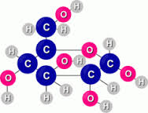
Molecules and Compound
Pure Substances
When elements chemically bond together, it creates molecules.
Molecules can be the same element bonded together or many different types of elements bonded together.
2 hydrogen atoms bonded together
Carbon, oxygen and Hydrogen bond to create a molecule of sugar.

Slide 10
Molecules and Compounds
Some molecules are called compounds.
Compounds are molecules that are made up of more than 1 type of atom.
For example (from previous slide)
NOT a Compound
Compound

Slide 11
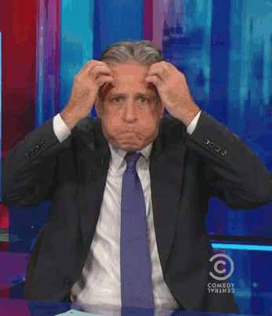
ALL compounds are molecules, but not all molecules are compounds.

Slide 12
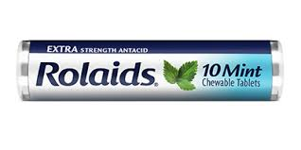
Some compounds have those scientific names like…..
Carbon Dioxide
Iron Oxide (rust)
Sodium Chloride (salt)
Sodium Bicarbonate (baking powder)
Dihydroxyaluminum sodium carbonate (Rolaids)

Slide 13
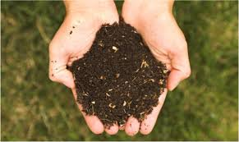
Mixtures
Not Pure Substances
Made up of 2 or more substances that are NOT chemically bonded.
Each substance keeps it’s own identity.
For example:
Air
Ocean Water
Soil
Trail mix

Slide 14
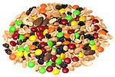
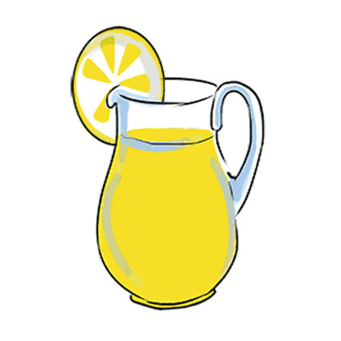
2 types of Mixtures
Heterogeneous Mixture – can see the different substances
Trail mix, Italian dressing, soil
“Shake well before use”
Homogeneous Mixture – appear to be same throughout (can not see different substances)
Air, milk, lemonade

Slide 15
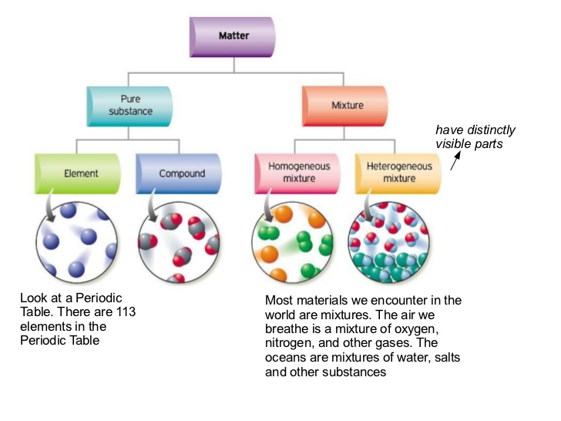

Slide 17
Test Codes for Retake Test must be submitted by 10 PM tonight!
2nd Period- 659403
3rd Period- 201065
4th Period- 724206
5th Period- 763598
6th Period- 466428
7th Period- 589441

Slide 18
Science Closure
While elemental molecules and compound molecules are related, they are different. Unlike elemental molecules, compounds–
A. consists of only one type of atom.
B. are the smallest form of a particle.
C. exist only as pure substances.
D. are made of at least two different elements.

