Slide 1
Homeroom Warm Up 9/18/17
On this day in 1851, the New York Times newspaper was first published. Do you think it’s important for students your age to keep up on current events? Why or why not?

Slide 2
CNN News 10 9/18/17
What did you find interesting?
Key facts about the segment
What is your opinion of the segment?
What would you still like to know about the topic?
*Take good notes as the news plays because you will be expected to write a 1 page summary once segment ends.

Slide 3
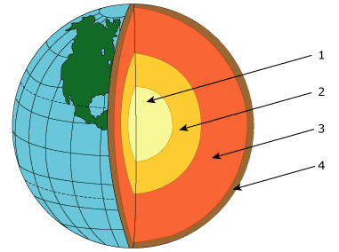
Science Warm Up 9/18/17
The diagram below shows Earth's layers. Which of the following layers is least dense?
Inner core
Mantle
Outer core
Crust

Slide 4
The Earth
Plate Tectonics
Notes:
Buy small jigsaw puzzles and have groups put them together.

Slide 5
Today’s Objectives
I can identify how tectonic plates move and the rate at which they move each year.
SPI 0707.7.5 Recognize that lithospheric plates on the scale of continents and oceans continually move at rates of centimeters per year.

Slide 6
https://www.youtube.com/watch?v=HrKTuCDierM

Slide 7
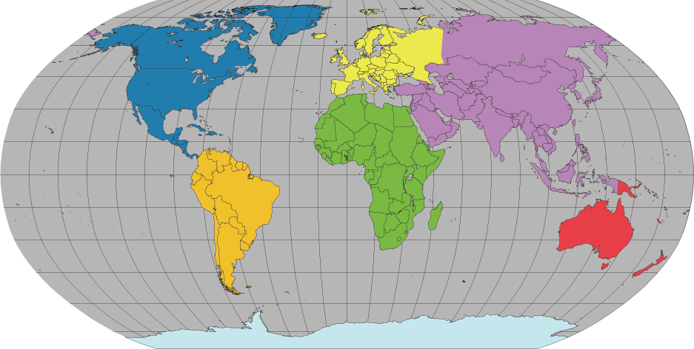
If you look at a map of the world, you may notice that some of the continents could fit together like pieces of a puzzle.
Notes:
If you look at a map of the world, you may notice that some of the continents could fit together like pieces of a puzzle…..the shape of Africa and South America are a good example.
This is because they DID used to fit together!
The Earth as we see it today was not always like it is now. Land masses have pulled apart and joined together by the process we call Plate Tectonics….

Slide 8
What is Plate Tectonics?
Notes:
Presenter: Ask the class if they have heard of Plate Tectonics before (commonly students will have some idea of the general concept), and ask them if they can explain the theory.

Slide 9
Plate Tectonics
The Earth’s crust is divided into 12 major plates which are moved in various directions.
This plate motion causes them to collide, pull apart, or scrape against each other.
Each type of interaction causes a characteristic set of Earth structures or “tectonic” features.
The word, tectonic, refers to the deformation of the crust as a consequence of plate interaction.
Notes:
There are 12 major plates on Earth, each of which slide around at a rate of centimetres per year, pulling away from, scraping against or crashing into each other.
Each type of interaction produces a characteristic “tectonic feature”, like mountain ranges, volcanoes and (or) rift valleys, that we will discuss during this lecture.

Slide 10
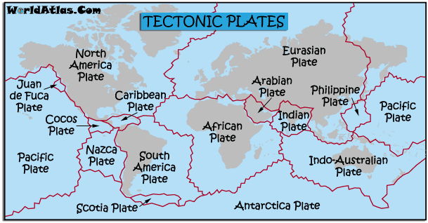
The lithosphere is divided into different pieces called tectonic plates.
Notes:
tectonic: very significant or considerable

Slide 11
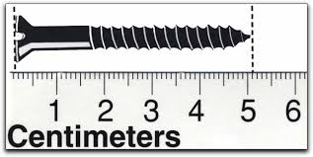
Lithospheric plates move over time, but they move very slowly. The plates only move a few centimeters each year (Around 2-10 cm)

Slide 12
Based on what we’ve learned so far, what do you think would make the lithospheric plates move?

Slide 13
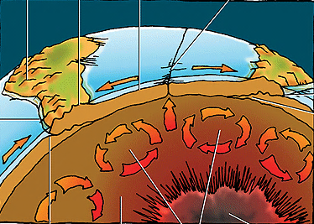
What’s the asthenosphere?
What are convection currents?

Slide 14
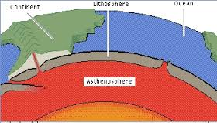
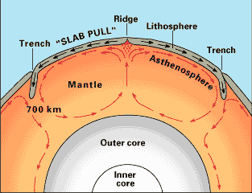
3. Lithospheric plates move because of the
convection currents in the asthenosphere.
As molten rock
rises from the core,
cools, and sinks, it
pushes the plates.

Slide 15
What happens at tectonic plate boundaries?
Notes:
We are now going to discuss the processes that occur at plate tectonic boundaries. What happens when plates meet?

Slide 16
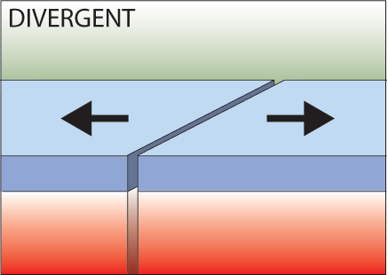
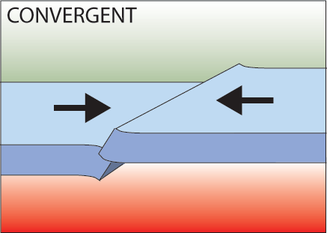
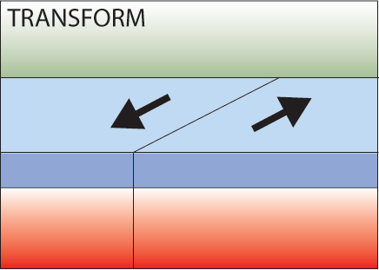
Three types of plate boundary
Divergent
Convergent
Transform
Notes:
Firstly, there are three types of plate boundary, each related to the movement seen along the boundary.
Divergent boundaries are where plates move away from each other
Convergent boundaries are where the plates move towards each other
Transform boundaries are where the plates slide past each other.
Presenter: See diagrams for each - it is important to remember the names of the boundary types and the motion involved.

Slide 17
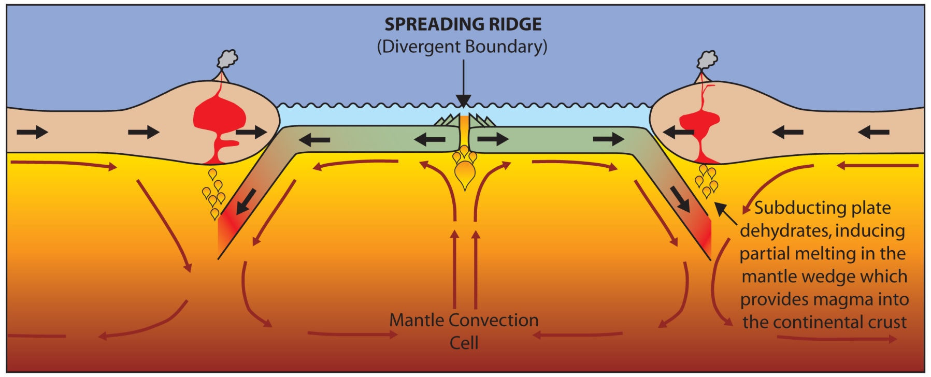
Divergent Boundaries
Spreading ridges
As plates move apart new material is erupted to fill the gap
Notes:
In plate tectonics, a divergent boundary is a linear feature that exists between two tectonic plates that are moving away from each other. These areas can form in the middle of continents or on the ocean floor.
As the plates pull apart, hot molten material can rise up this newly formed pathway to the surface - causing volcanic activity.
Presenter: Reiterate the process by going through the diagram, including the presence of mantle convection cells causing the plates to break apart and also as a source for new molten material.
Where a divergent boundary forms on a continent it is called a RIFT or CONTINENTAL RIFT, e.g. African Rift Valley.
Where a divergent boundary forms under the ocean it is called an OCEAN RIDGE.

Slide 18
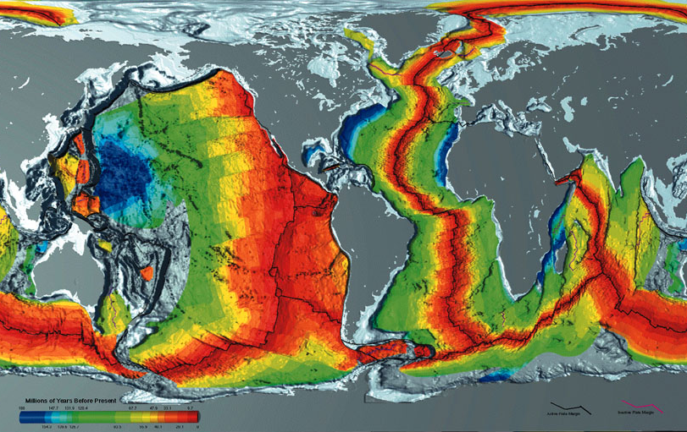
Age of Oceanic Crust
Courtesy of www.ngdc.noaa.gov
Notes:
Ocean Ridges: This map shows the age of the oceanic crust. The red colouring shows the youngest ages, whilst the dark blue shows the oldest ages (around 200 million years old).
Presenter ask: Where are the Ocean Ridges located? I.e. where are the divergent boundaries?
Answer: The divergent boundaries are where the plates are pulling apart and new material is being produced. Therefore the Ocean ridges are in the middle of the red areas (the boundaries are in fact shown on the map). We can see a progression of the oceanic crust getting older away from the ocean ridges (like a conveyer belt).
Presenter: Before moving on to the next slide, point out Iceland. The divergent boundary runs straight through Iceland….

Slide 19
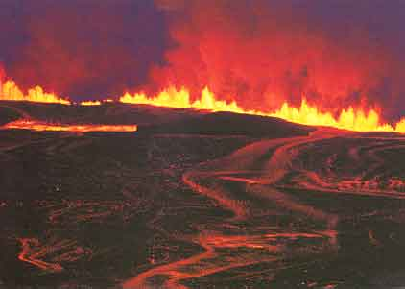
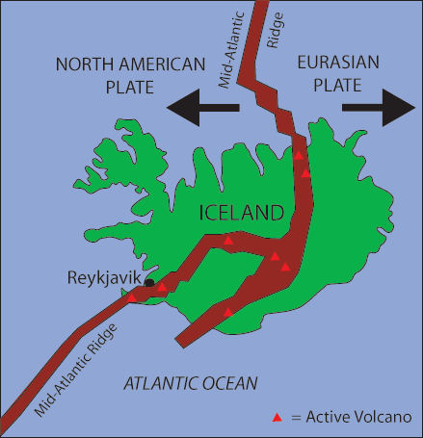
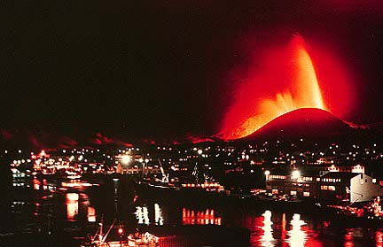
Iceland: An example of continental rifting
Iceland has a divergent plate boundary running through its middle
Notes:
Iceland is located right on top of a divergent boundary. In fact, the island exists because of this feature.
As the North American and Eurasian plates were pulled apart (see map) volcanic activity occurred along the cracks and fissures (see photographs).
With many eruptions over time the island grew out of the sea!
Question: Why don’t we have islands like Iceland where ever we get an Ocean Ridge?
Answer: Scientists believe that there is a large mantle plume (an upwelling of hot mantle material) located right underneath where Iceland has formed. This would mean that more material would be erupted in the Iceland area compared with if there was just the divergent boundary without the plume underneath it.

Slide 20
Convergent Boundaries
There are three styles of convergent plate boundaries
Continent-continent collision
Continent-oceanic crust collision
Ocean-ocean collision
Notes:
Convergent boundaries are where the plates move towards each other.
There are three types of convergent boundary, each defined by what type of crust (continental or oceanic) is coming together.
Therefore we can have: continent-continent collision, continent-oceanic crust collision or ocean-ocean collision….

Slide 21
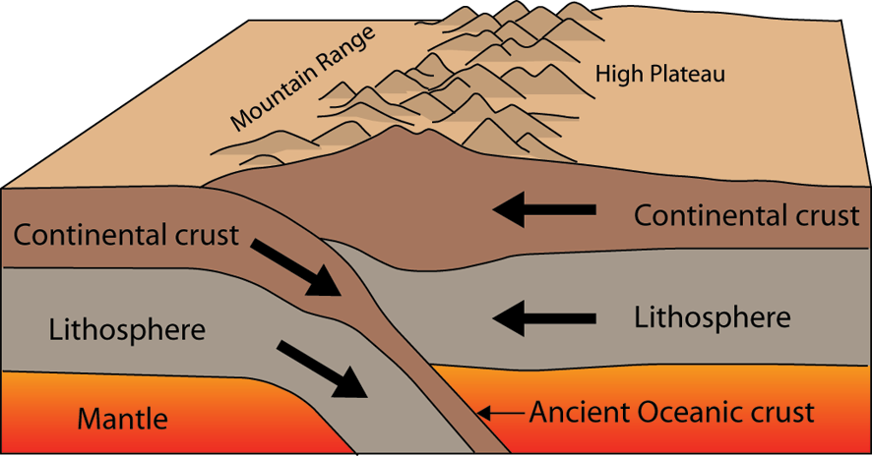
Continent-Continent Collision
Forms mountains, e.g. European Alps, Himalayas
Notes:
When continental crust pushes against continental crust both sides of the convergent boundary have the same properties (think back to the description of continental crust: thick and buoyant). Neither side of the boundary wants to sink beneath the other side, and as a result the two plates push against each other and the crust buckles and cracks, pushing up (and down into the mantle) high mountain ranges. For example, the European Alps and Himalayas formed this way.

Slide 22
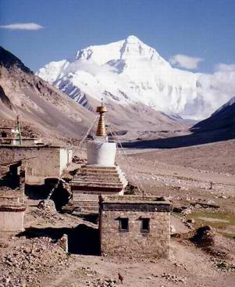
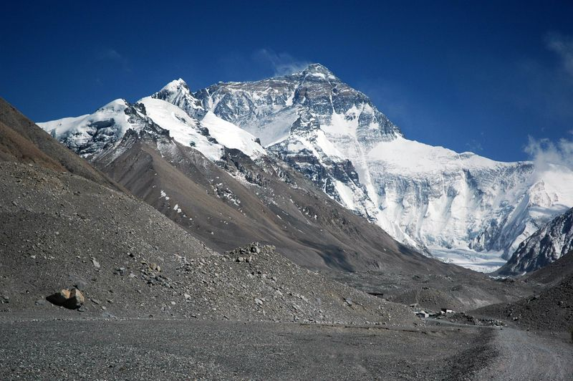
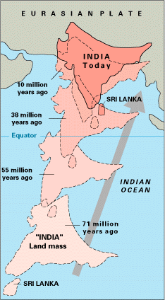
Himalayas
Notes:
Example:
India used to be an island, but about 15 million years ago it crashed into Asia (see map).
As continental crust was pushing against continental crust the Himalayan mountain belt was pushed up.
“Mountains” were also pushed down into the mantle as the normally 35 km thick crust is approximately 70 km thick in this region.
Mt Everest is the highest altitude mountain on our planet standing 8,840 metres high. This means that below the surface at the foot of the mountain the crust is a further 61 km deep!!

Slide 23
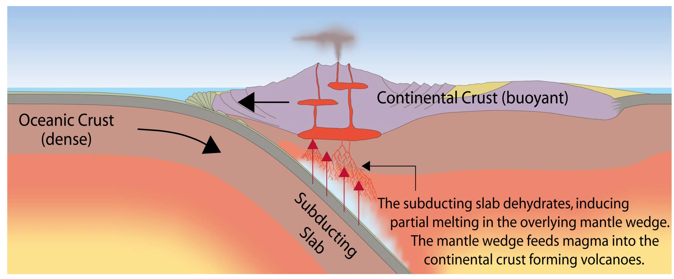
Continent-Oceanic Crust Collision
Called SUBDUCTION
Notes:
At a convergent boundary where continental crust pushes against oceanic crust, the oceanic crust which is thinner and more dense than the continental crust, sinks below the continental crust.
This is called a Subduction Zone.
The oceanic crust descends into the mantle at a rate of centimetres per year. This oceanic crust is called the “Subducting Slab” (see diagram).
When the subducting slab reaches a depth of around 100 kilometres, it dehydrates and releases water into the overlying mantle wedge (Presenter: explain all of this using the diagram).
The addition of water into the mantle wedge changes the melting point of the molten material there forming new melt which rises up into the overlying continental crust forming volcanoes.
Subduction is a way of recycling the oceanic crust. Eventually the subducting slab sinks down into the mantle to be recycled. It is for this reason that the oceanic crust is much younger than the continental crust which is not recycled.

Slide 24
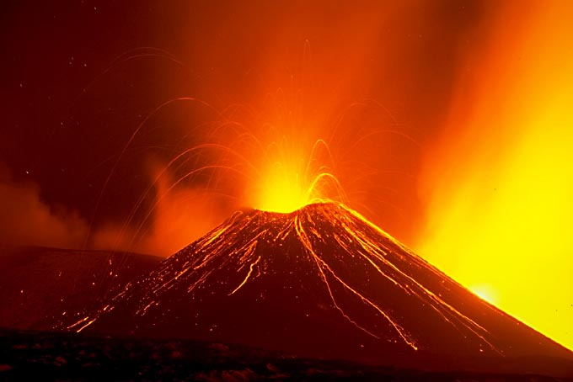
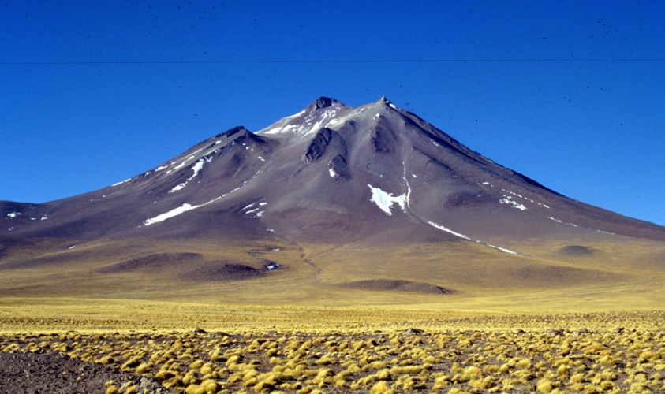
Subduction
Oceanic lithosphere subducts underneath the continental lithosphere
Oceanic lithosphere heats and dehydrates as it subsides
The melt rises forming volcanism
E.g. The Andes
Notes:
The Andes mountain range along the western edge of the South American continent is an example of a mountain belt formed by subduction.
The continental crust of the South American plate has buckled under the compressional strain of converging with the Nasca and Antarctic plates. Additionally there are many volcanoes, the result of melting of the subducting slab and the production of new material that has risen through the crust to the surface.

Slide 25
Ocean-Ocean Plate Collision
When two oceanic plates collide, one runs over the other which causes it to sink into the mantle forming a subduction zone.
The subducting plate is bent downward to form a very deep depression in the ocean floor called a trench.
The worlds deepest parts of the ocean are found along trenches.
E.g. The Mariana Trench is 11 km deep!
Notes:
When two oceanic plates converge, because they are dense, one runs over the top of the other causing it to sink into the mantle and a subduction zone is formed.
The subducting plate is bent down into the mantle to form a deep depression in the seafloor called a trench.
Trenches are the deepest parts of the ocean and remain largely unexplored.

Slide 26
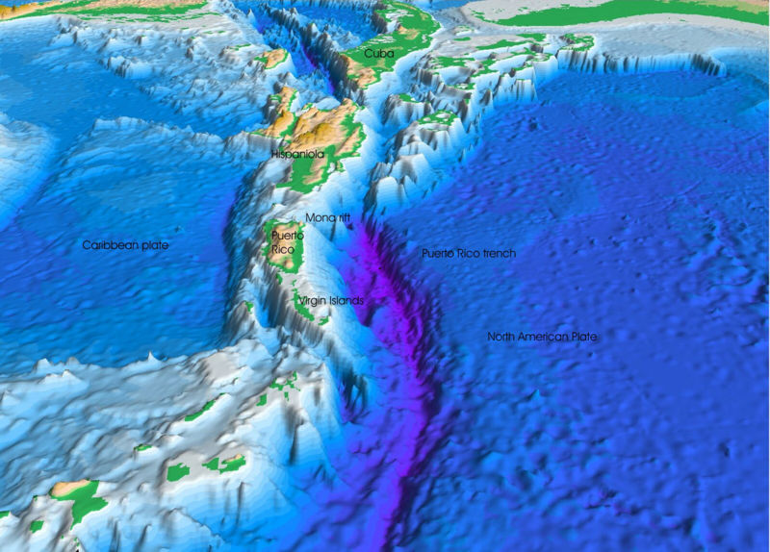
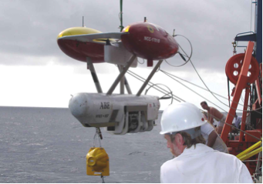
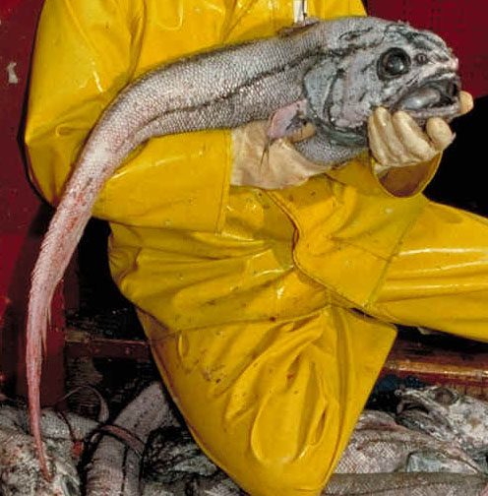
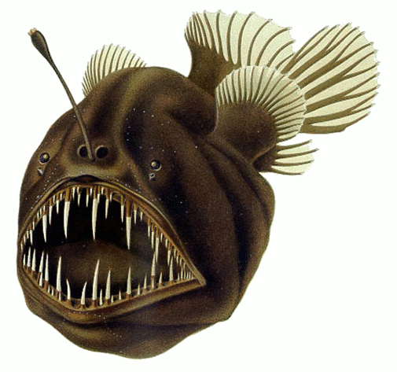
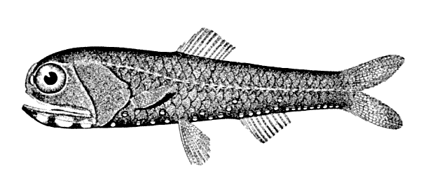
Notes:
Manned or unmanned submersible vehicles (top right photo) have explored small parts of trenches discovering new species (like the fish photographed here) and amazing ecosystems.

Slide 27
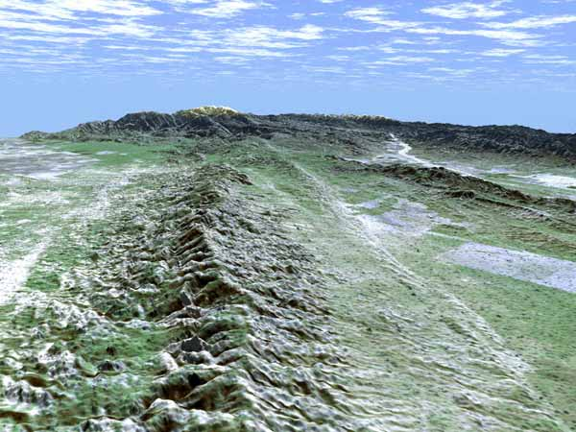
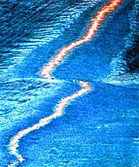
Transform Boundaries
Where plates slide past each other
Above: View of the San Andreas transform fault
Notes:
The third type of boundary are transform boundaries, along which plates slide past each other.
The San Andreas fault, adjacent to which the US city of San Francisco is built is an example of a transform boundary between the Pacific plate and the North American plate.

Slide 28
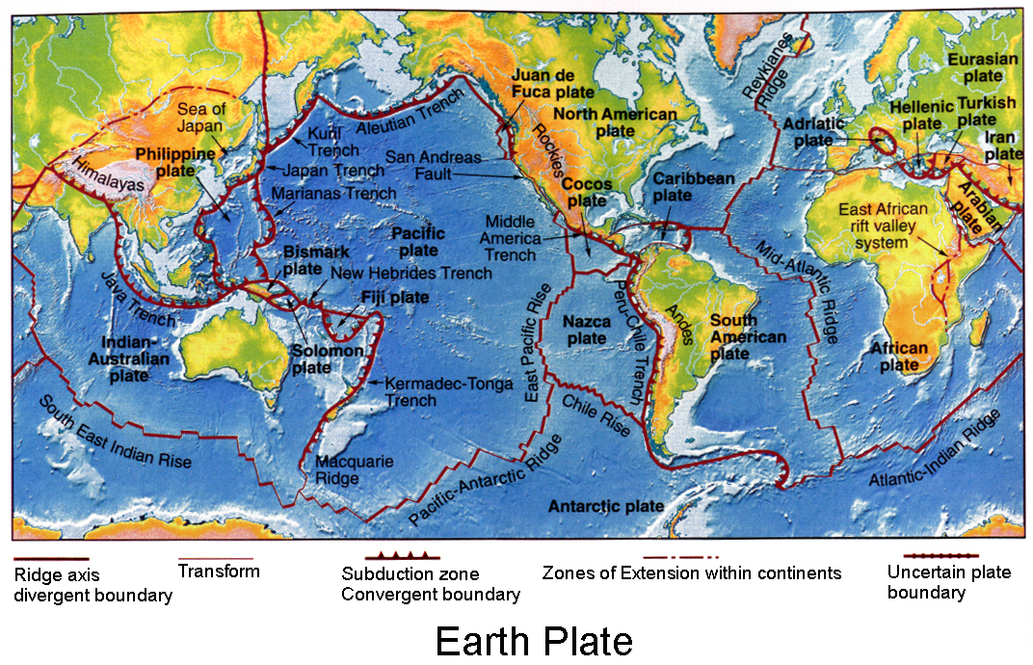
Notes:
This map summarises all the known plate boundaries on Earth, showing whether they are divergent, convergent or transform boundaries.

Slide 29
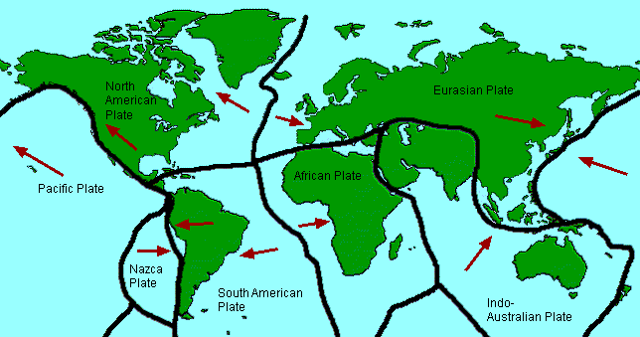
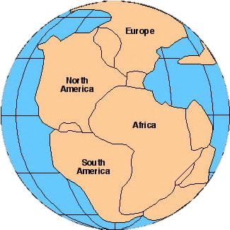
4. Since continents are part of the plates, as the plates move, the continents move.
5. 200 million years ago, all of the continents were once next to each other and formed a “supercontinent.” This supercontinent is called Pangaea.

Slide 30
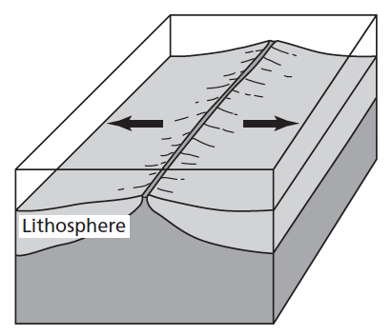
Science Closure 9/18/17
The diagram shows two lithospheric plates moving away from each other. Which best describes plate movement rate?
50 kilometers per year
5 kilometers per year
50 meters per year
5 centimeters per year
Notes:
D.

Slide 31
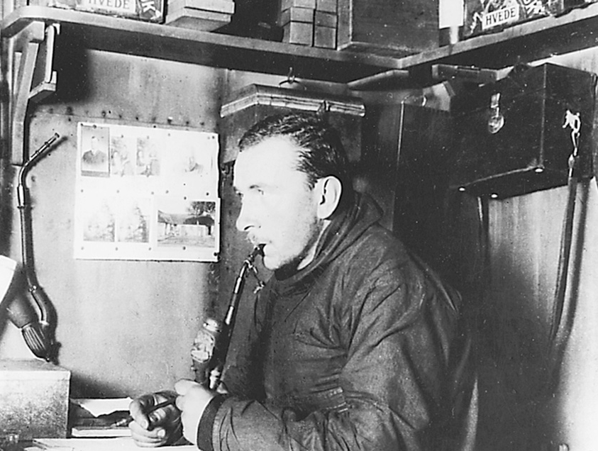
CONTINENTAL DRIFT
6. Alfred Wegener, in the early 1900s, proposed the hypothesis that continents were once joined together in a single large landmass he called Pangaea (meaning “all earth” in Greek).
A. He proposed that Pangaea had split apart and the continents had moved gradually to their present positions - a process that became known as continental drift.

Slide 32
YouTube: Alfred Wegener

Slide 33
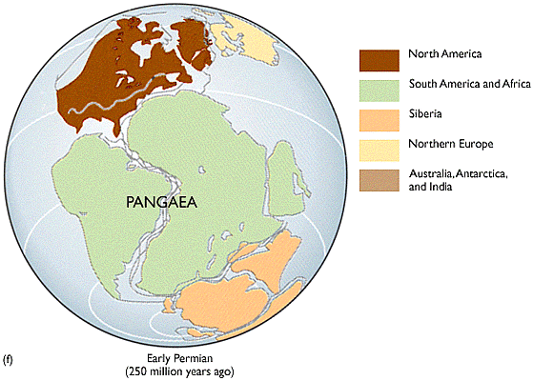
CONTINENTAL DRIFT
B. According to the hypothesis of continental drift, continents have moved slowly to their current locations.
Approximately how much do they move each year?

Slide 34
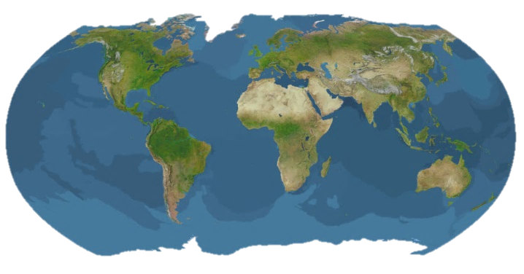
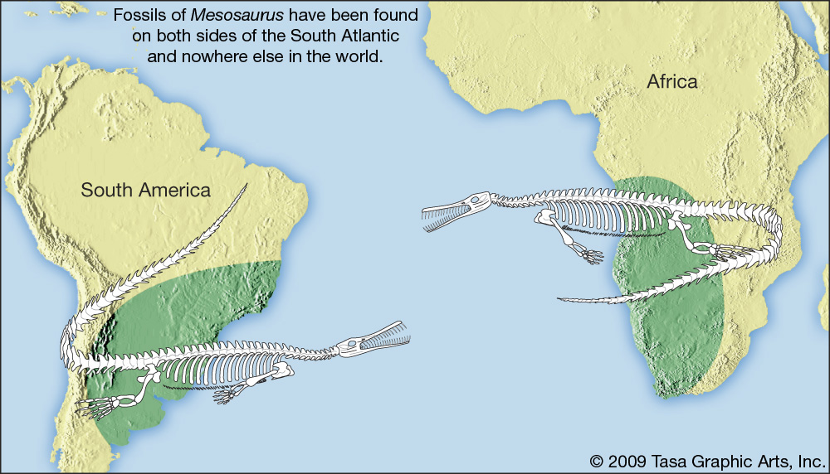
7. Three pieces of evidence tell us the continents once fit together.
The continents fit together like puzzle pieces.
Identical plant and animal fossils of the same age have been found in rocks in Africa and South America.
Matching rock formations and mountain chains found on different continents.
Notes:
This means that the same plants and animals lived in these two places millions of years ago.

Slide 35
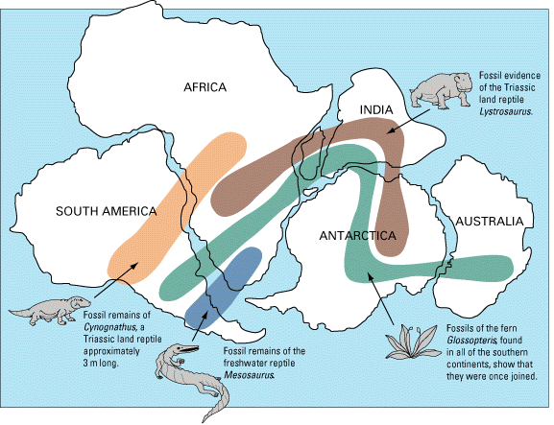

Slide 36
Check for Understanding
What happens to continents when the lithospheric plates move?
Notes:
Since continents are part of the tectonic plates, as the plates move, the continents move.

Slide 37
Check for Understanding
Scientists theorize that millions of years ago South America and Africa formed a single land mass.
Why are South America and Africa now thousands of miles apart?
Notes:
A.

Slide 38
Guided Practice

Slide 39
Guided Practice Expectations
Seated & Silent
Raise a silent hand to answer.
Don’t blurt out your answer!

Slide 40
Guided Practice
1. Does the picture at the right show Pangaea? Explain your answer.
2. What motion in the asthenosphere has caused the continents to move?
Notes:
no
convection currents

Slide 41
3. The diagram shows two lithospheric plates moving away from each other.
Which best describes plate movement rate?
50 kilometers per year
5 kilometers per year
50 meters per year
5 centimeters per year
Notes:
D.

Slide 42
Independent Practice Expectations
Seated & Silent
Raise a silent hand if you have a question.

Slide 43
Exit Ticket Expectations
Seated & Silent
Raise a silent hand if you have a question.
You can’t use your notes!

Slide 44
1. The lithosphere is broken into different pieces that move over time. What are these pieces called?
Pangaea
Tectonic Plates
Fossils
Supercontinents
Notes:
B

Slide 45
2. Which distance below could be the distance that a piece of the lithosphere would move in one year?
It could move 5 millimeters
It could move 12 meters
It could move 5 centimeters
It could move 12 kilometers
Notes:
C

Slide 46
3. A force causes the pieces of Earth’s lithosphere to move. What causes this force and where does it occur?
Jet streams in the California Current and Gulf Stream Current.
Jet streams in the troposphere and stratosphere.
Convection currents in the inner and outer core
Convection currents in the asthenosphere.
Notes:
D

Slide 47
4. What is Pangaea?
The idea that the continents are moving closer together.
The idea that the continents are moving apart.
The idea that the continents were once all connected.
The idea that the continents never move.
Notes:
C

