Slide 1
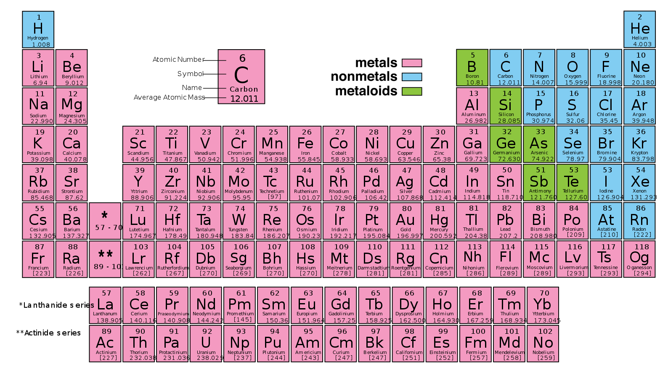
Metals, Non-Metals, and Metalloids
Use the handout to colour your top periodic table like this. Make sure you include a legend

Slide 2
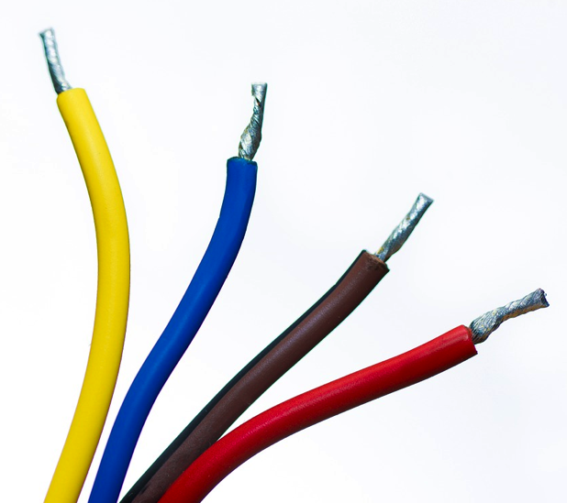
Properties of Metals
Metals are good conductors of heat and electricity
Metals are shiny
Metals are ductile (can be stretched into thin wires)
Metals are malleable (can be pounded into thin sheets)
A chemical property of metal is its reaction with water, which results in corrosion

Slide 3
Properties of Non-Metals
Non-metals are poor conductors of heat and electricity
Non-metals are not ductile or malleable
Solid non-metals break easily.
They are dull
Many non-metals are gases

Slide 4
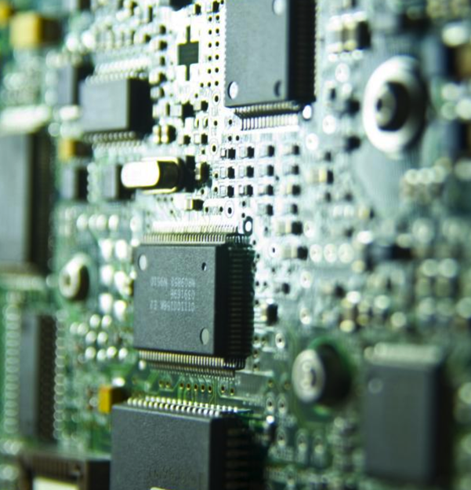
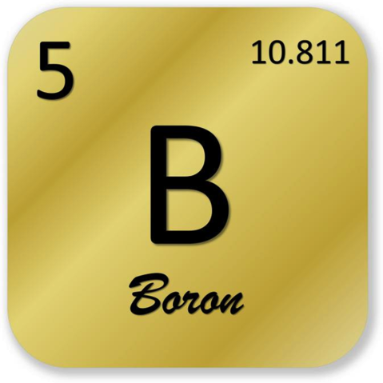
Properties of Metalloids
Metalloids (metal-like) have properties of both metals and non-metals.
They are solids that can be shiny or dull.
They conduct heat and electricity better than non-metals but not as well as metals.
They are ductile and malleable.
Silicon is used in many computer chips

Slide 5
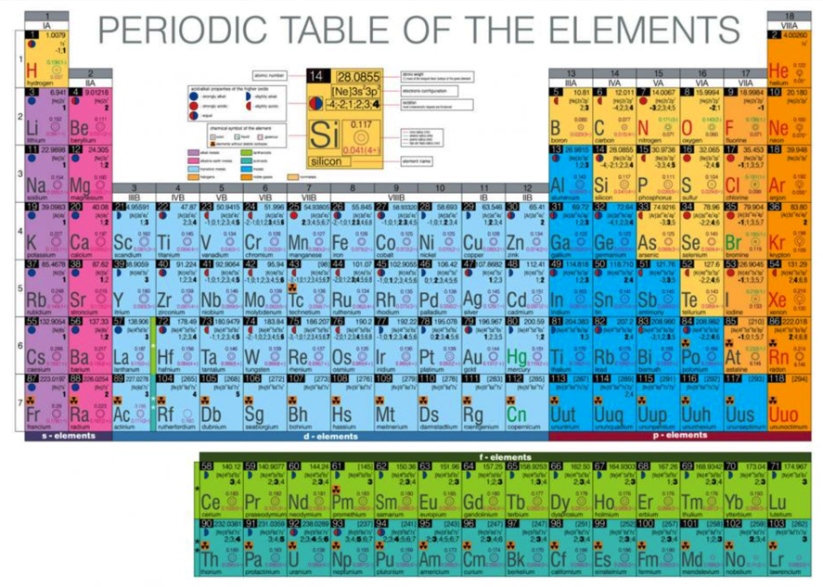
Groups and Families
Elements in the periodic table are group into 18 columns
Each element within a column or group contains the same number of valence electrons
This results in them having similar properties

Slide 6
Rows and Periods
Elements in the periodic table are also grouped into rows or periods
The periods are numbered 1-7
Elements within a period do not share common characteristics but they share the same # of energy levels.

