Slide 1
Science Warm Up 11/26/18
What cell structure stores water and is indicated by the number 1 in the diagram?
A. Lysosome
B. Mitochondria
C. Chloroplast
D. Vacuole

Slide 2
Levels of Organization
7th Grade Science

Slide 3
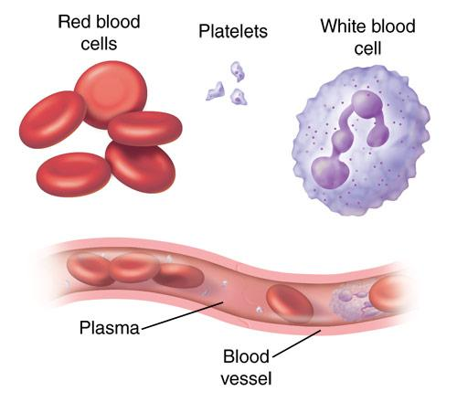
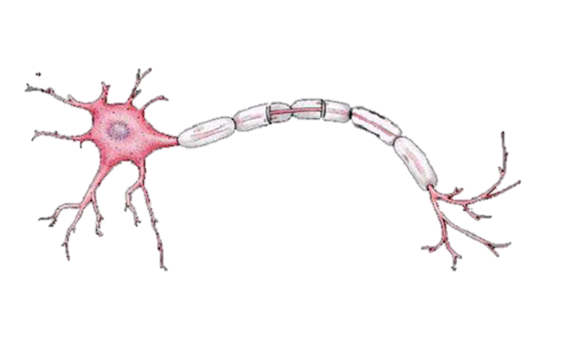
Levels of Organization
CELLS
The basic unit of structure & function of all living things
Most simple level of organization
Examples: Red Blood Cells, Nerve Cells

Slide 4
Levels of Organization
TISSUES
A group of cells connected together that all do the same thing
Examples: muscle tissue, epithelial tissue, nervous tissue, & connective tissue

Slide 5
Levels of Organization
TISSUES
A group of cells connected together that all do the same thing
Examples: muscle tissue, epithelial tissue, nervous tissue, & connective tissue

Slide 6
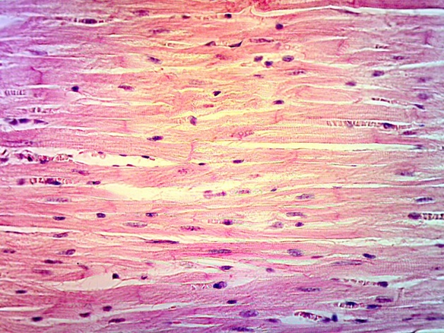
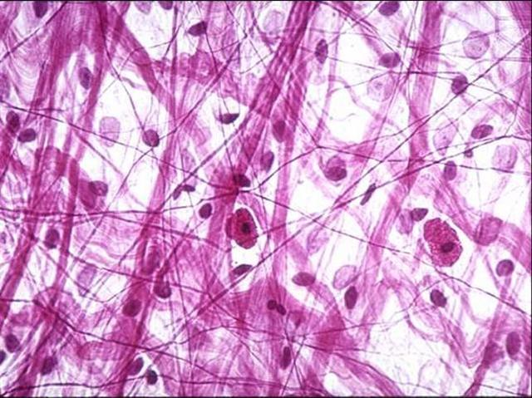
Levels of Organization
TISSUES
A group of cells connected together that all do the same thing
Examples: muscle tissue, epithelial tissue, nervous tissue, & connective tissue

Slide 7
Levels of Organization
OrganS
A group of tissues layered together that all work together to do the same thing
Examples: heart, liver, brain, skin

Slide 8
Levels of Organization
OrganS
A group of tissues layered together that all work together to do the same thing
Examples: heart, liver, brain, skin

Slide 9
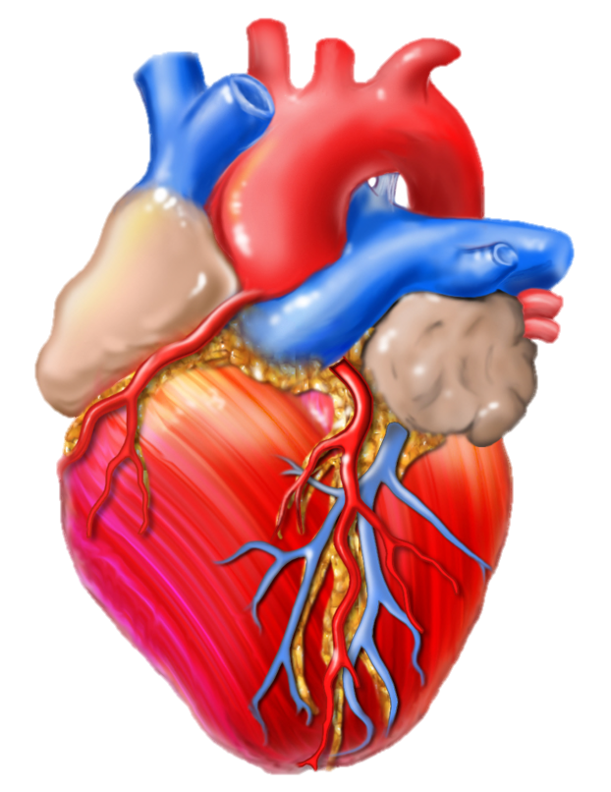
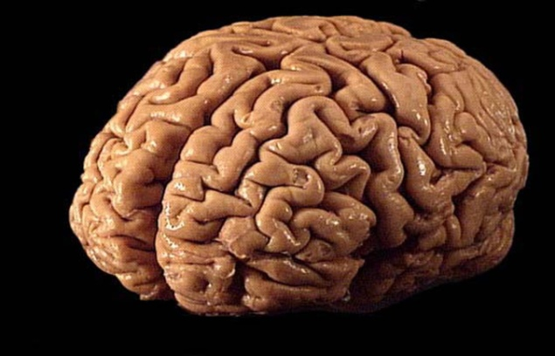
Levels of Organization
OrganS
A group of tissues layered together that all work together to do the same thing
Examples: heart, liver, brain, skin
Notes:
Heart image found at http://scjenkinsart.files.wordpress.com/2011/02/heart-graphic.jpg

Slide 10
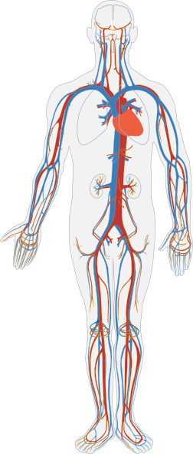
Levels of Organization
Organ
Systems
A group of organs that work together to perform certain functions
Examples: circulatory system (blood, heart, lungs, etc.) and nervous system (brain, nerves, spinal cord, etc.)
Notes:
Heart image found at http://scjenkinsart.files.wordpress.com/2011/02/heart-graphic.jpg, Circulatory System image found at http://www.clker.com/cliparts/3/U/t/k/4/o/circulatory-system-no-labels-hi.png

Slide 11
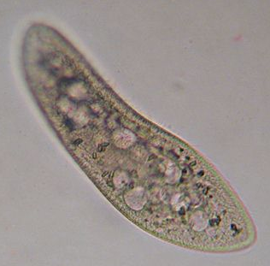
Levels of Organization
Organisms
A living thing that can carry out all life processes
Most complex level of organization
Some organisms are made of only one cell (like bacteria & paramecium)
Notes:
Circulatory System image found at http://www.clker.com/cliparts/3/U/t/k/4/o/circulatory-system-no-labels-hi.png, Person image found at http://www.illustrationsof.com/royalty-free-boy-clipart-illustration-37090.jpg, paramecium image found at http://www.microscope-microscope.org/gallery/Mark-Simmons/images/paramecium2.jpg, Tree image found at http://gallery.yopriceville.com/var/albums/Free-Clipart-Pictures/Trees-PNG-Clipart/Green_Painted_Tree_PNG_Clipart.png, mushroom picture found at http://fc02.deviantart.net/fs37/f/2008/284/5/9/Mushroom_Madness_8_by_Dracoart_Stock.jpg, Bacteria image found at http://themindfulfoodie.com/wp-content/uploads/2012/09/bacteria.jpg, Bird image found at http://1.bp.blogspot.com/-oenpSnKmkRI/Twgc0bwSErI/AAAAAAAAARg/hWWG9IGPKIk/s640/8aug11galahs2sturtNP+%2528180%2529.jpg

Slide 12
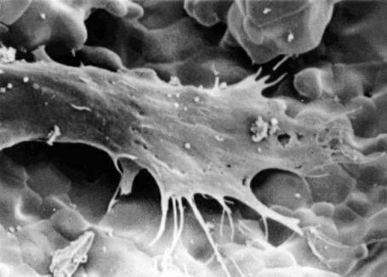
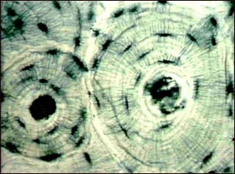
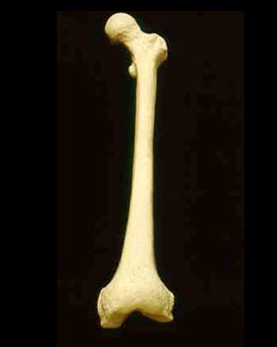
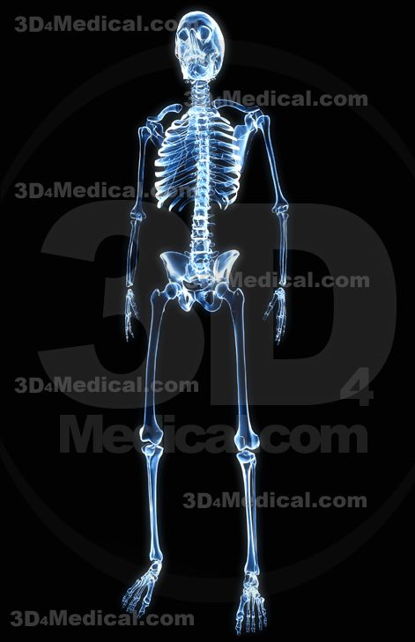
The levels of organization from simplest to most complex are:
Cells
Tissues
Organs
System
Organism

Slide 13
Let’s Review….
1st Level: Cells working together form
2nd Level: Tissues, which can form
3rd Level: Organs, which work together to form
4th Level: Organ Systems, which work together to form
5th Level: Organisms!

Slide 14
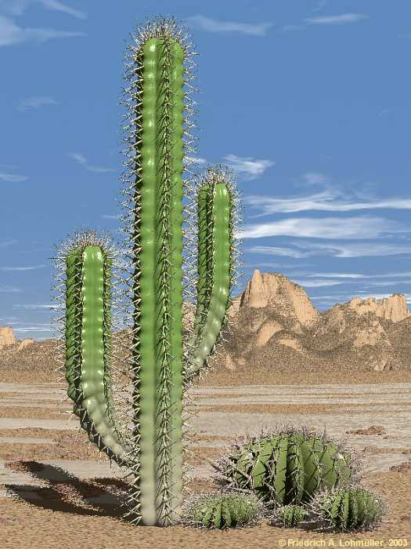
A cell, tissue, organ, system, or organism?
Found: Cacti are often found in desert environments
Function: to live and survive in its environment
ORGANism
Notes:
Cactus picture found at http://www.himhministries.com/uploads/2/5/6/8/25688620/3168713_orig.jpg

Slide 15
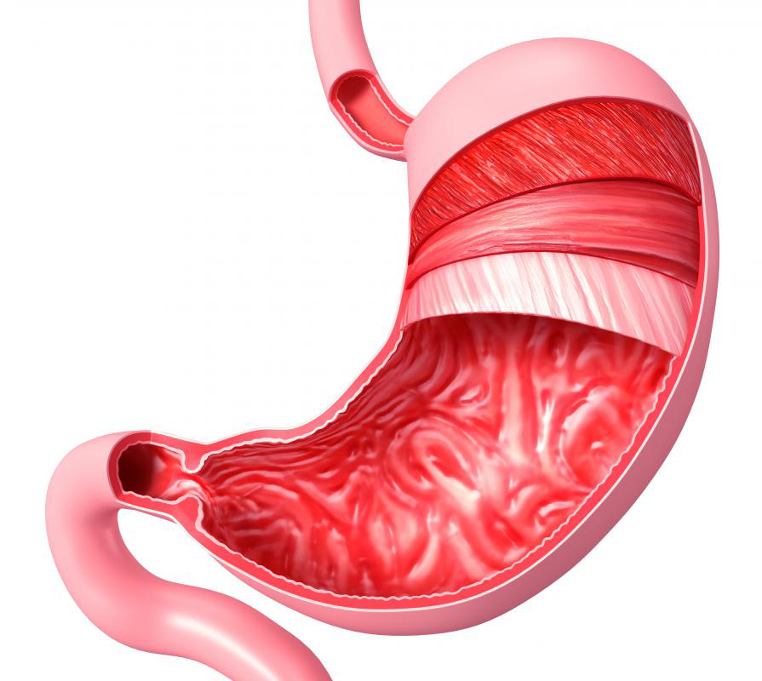
A cell, tissue, organ, system, or organism?
Found: the stomach is part of the digestive tract in many animals
Function: to break down food, and store it to later be absorbed by the intestines
ORGAN
Notes:
Stomach picture found at http://www.newhopemedicalcenter.com/wp-content/uploads/2012/06/stomach.jpg

Slide 16
A cell, tissue, organ, system, or organism?
Found: the circulatory system is in the human body, as well as many other organisms
Function: It transports oxygen and sugar to all cells within the body
SYSTEM
Notes:
Circulatory System image found at http://www.clker.com/cliparts/3/U/t/k/4/o/circulatory-system-no-labels-hi.png

Slide 17
A cell, tissue, organ, system, or organism?
Found: These are various layers of cells found inside the human body
*epithelial
*nervous
*muscle
*connective
Function: Each of these has its own function, what do you think they are?
TISSUE
Notes:
Tissue picture found at http://editions.sciencetechnologyaction.com/lessons/3/47/fig1.jpg

Slide 18
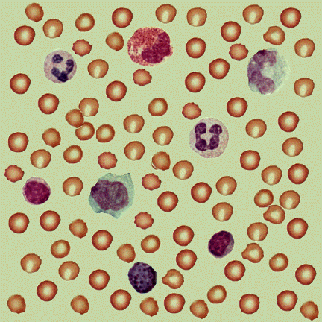
A cell, tissue, organ, system, or organism?
Found: these are different types of red and white blood cells found in our blood
Function: red blood cells transport oxygen to other body parts, white blood cells fight off diseases
What level is our blood?
CELLS
Notes:
Blood cells image found at http://textbookofbacteriology.net/Blood.gif

Slide 19
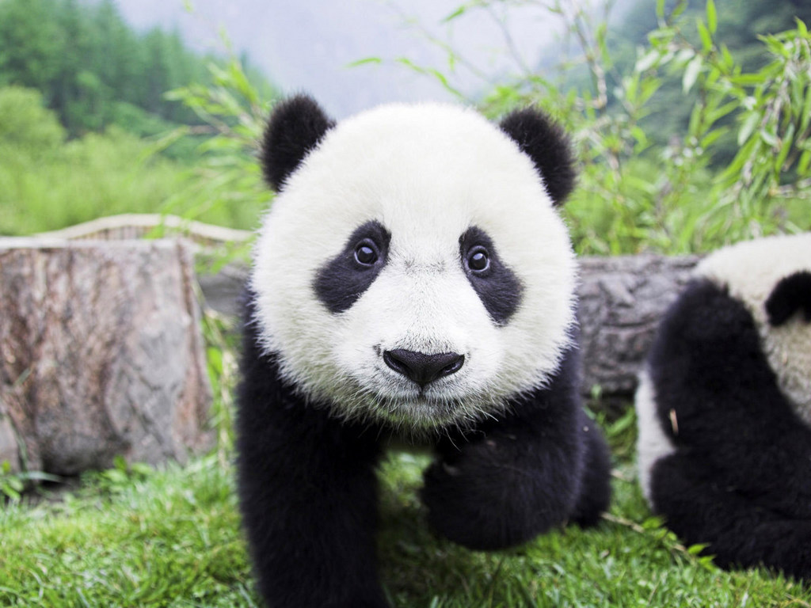
A cell, tissue, organ, system, or organism?
Found: in China
Function: to live and survive in the wild
ORGANISM
Notes:
Panda picture found at http://www.mlmguides.com/wp-content/uploads/2011/09/panda-bear1.jpg

Slide 20
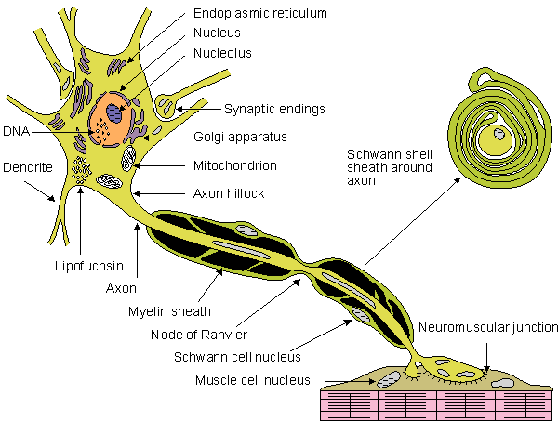
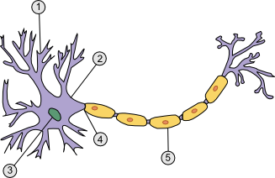
A cell, tissue, organ, system, or organism?
Found: in our brain, our nervous tissue is made up of millions of these
Function: neurons transmit signals to body parts to tell them what to do
CELLS
Notes:
Nerve cell images found at http://www.sciencegeek.net/Biology/review/graphics/Unit8/neuron.png and http://upload.wikimedia.org/wikipedia/en/e/e9/Nerve_cells.gif

Slide 21
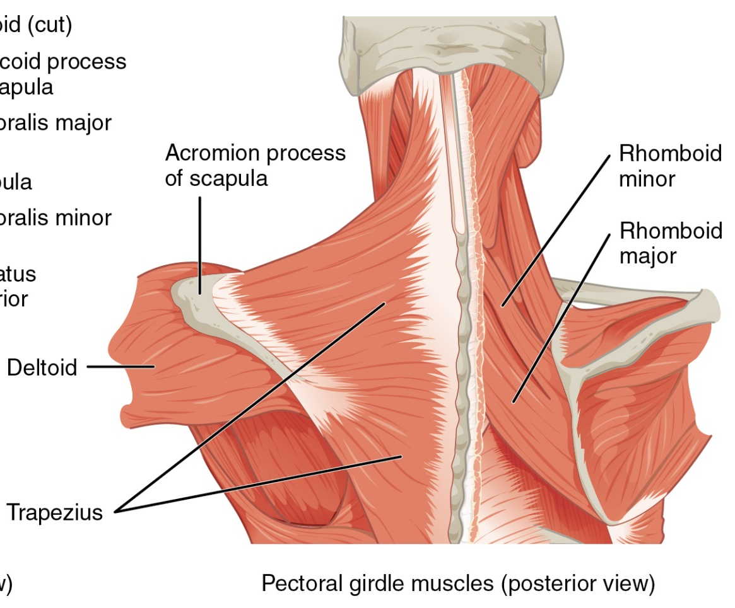
A cell, tissue, organ, system, or organism?
Found: All over our bodies
Function: muscles help us to move, pump blood, and support our skeleton
TISSUES
Notes:
Muscle image found at http://cnx.org/content/m46495/latest/1118_Muscles_that_Position_the_Pectoral_Girdle.jpg

Slide 22
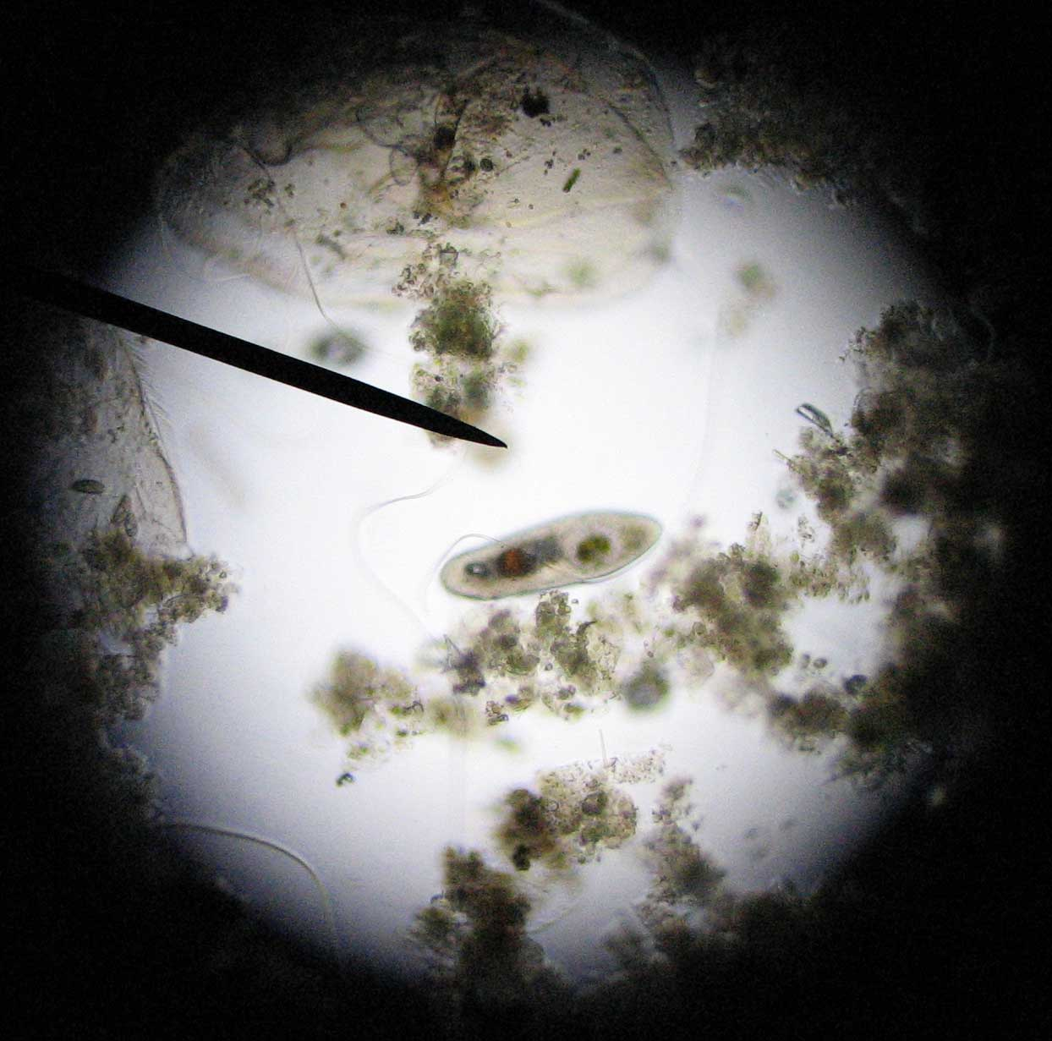
A cell, tissue, organ, system, or organism?
Found: paramecium are often found in pond water
Function: to live and survive in their environment
ORGANISM
Notes:
Paramecium image found at http://www.artscape.us/aquaculture/paramecium/paramecium_0035.jpg

Slide 23
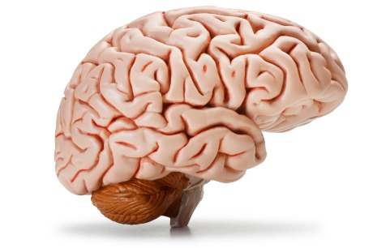
A cell, tissue, organ, system, or organism?
Found: Found in many animals as part of the nervous system
Function: sends and receives signals throughout the body
ORGAN
Notes:
Brain Image found at http://www.nuffieldfoundation.org/sites/default/files/images/brain.jpg

Slide 24
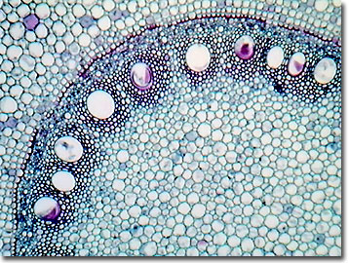
A cell, tissue, organ, system, or organism?
Found: Corn stem tissue can be found in the root tips of corn plants
Function: Helps send water & other nutrients to various parts of the plant
Tissue
Notes:
Corn Stem Tissue Image found at http://micro.magnet.fsu.edu/optics/olympusmicd/galleries/brightfield/images/cornstemlow.jpg

Slide 25
A cell, tissue, organ, system, or organism?
Found: The Maple leaf is found on branches of Maple Trees
Function: Made of many layers of various tissues, maple leaves are vital in using energy from the sunlight to make food (photosynthesis)
Organ
Notes:
Maple Leaf Image found at http://upload.wikimedia.org/wikipedia/commons/c/c6/Freeman_maple_leaf.jpg

Slide 26
Science Closure 11/26/18
What are the 5 levels of Organization of Life from smallest to largest?

