Slide 1
Homeroom Warm Up 1/04/2021
Write a 1 paragraph summary to describe how you spent your winter break. What did you enjoy most about the break? What did you enjoy least about the break? Explain why

Slide 2
Science Warm Up 1/04/2021
In which of the following kingdoms would you find unicellular organisms that do NOT have nuclei?
a. Fungi
b. Archaebacteria
c. Protist
d. None of the above

Slide 3
Take a look at the picture below and complete the following sentences with your own responses
1. This makes me think of….
2. I wonder….
3. I have some questions….
4. This makes me want to….
In 2011, the first synthetic organ transplant occurred in Sweden. Scientists in London created an artificial windpipe which was then coated in stem cells from the patient.

Slide 4
Levels of Organization
Textbook pages 190-199

Slide 5
having or consisting of many cells
to create or produce
a smaller representation
arrangement
SWBAT develop a model of organization in multicellular organisms IOT explain the hierarchy from cells to organisms.
a system or organization in which groups are ranked one above the other according to status or authority
- A living thing; anything that can carry out life processes independently.
The smallest unit that can perform all life processes.

Slide 6
Word Wall
Organisms- A living thing; anything that can carry out life processes independently.
Tissue- A group of similar cells that perform a common function.
Organ- A collection of tissues that carry out a specialized function of the body.
Organ System- A group of organs that work together to perform body functions.
Structure- The arrangement of parts in an organism.
Function- The special, normal, or proper activity of an organ or part.

Slide 7
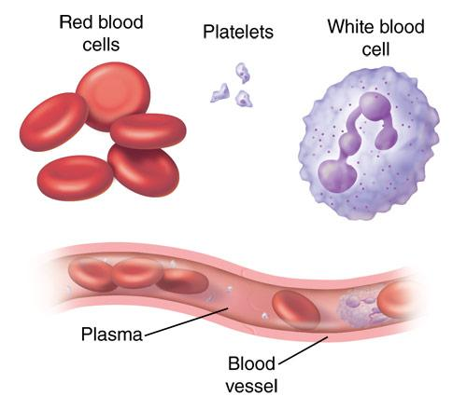
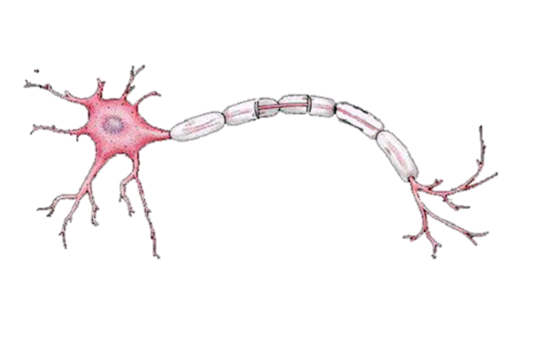
Levels of Organization
CELLS
The basic unit of structure & function of all living things
Most simple level of organization
Examples: Red Blood Cells, Nerve Cells

Slide 8
Levels of Organization
TISSUES
A group of cells connected together that all do the same thing
Examples: muscle tissue, epithelial tissue, nervous tissue, & connective tissue

Slide 9
Levels of Organization
TISSUES
A group of cells connected together that all do the same thing
Examples: muscle tissue, epithelial tissue, nervous tissue, & connective tissue

Slide 10
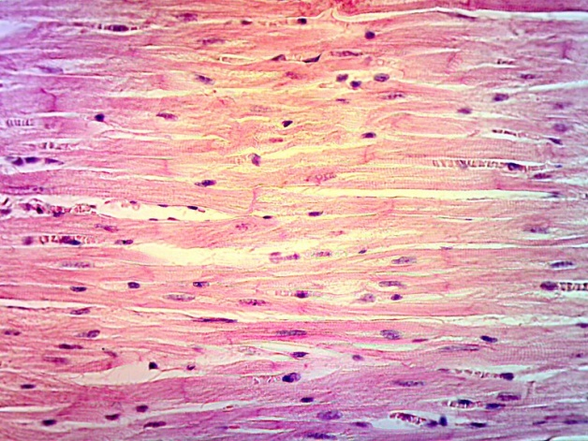
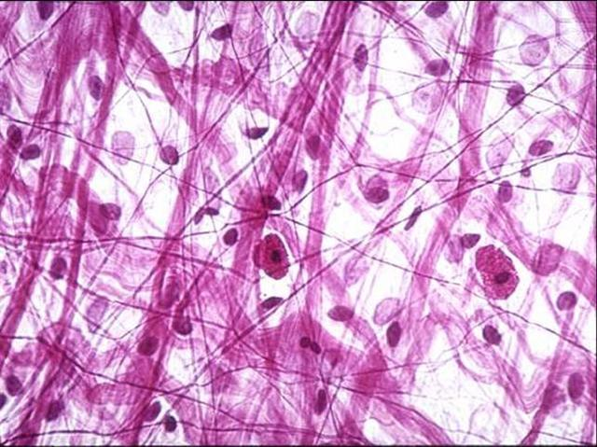
Levels of Organization
TISSUES
A group of cells connected together that all do the same thing
Examples: muscle tissue, epithelial tissue, nervous tissue, & connective tissue

Slide 11
Levels of Organization
OrganS
A group of tissues layered together that all work together to do the same thing
Examples: heart, liver, brain, skin

Slide 12
Levels of Organization
OrganS
A group of tissues layered together that all work together to do the same thing
Examples: heart, liver, brain, skin

Slide 13
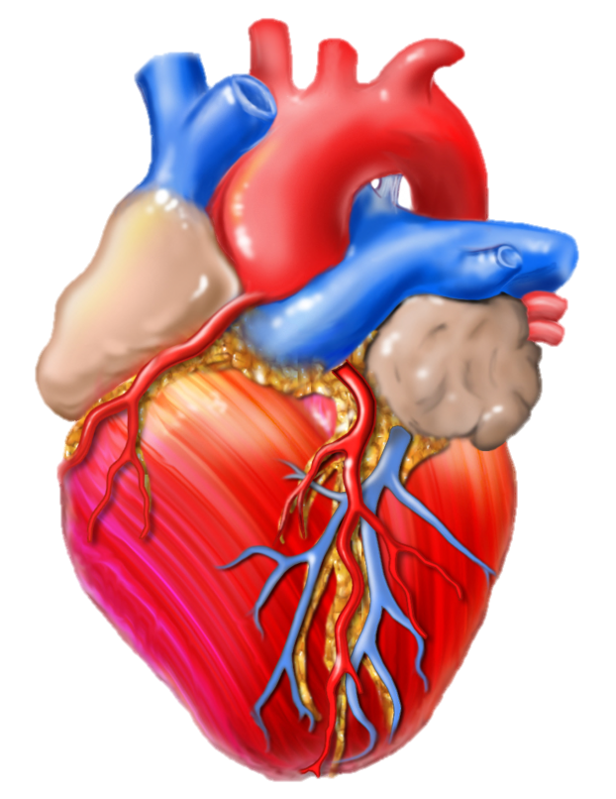
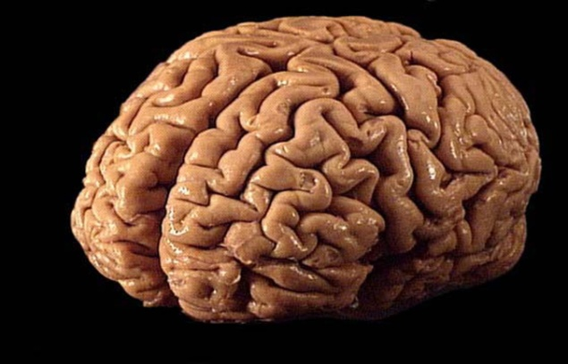
Levels of Organization
OrganS
A group of tissues layered together that all work together to do the same thing
Examples: heart, liver, brain, skin
Notes:
Heart image found at http://scjenkinsart.files.wordpress.com/2011/02/heart-graphic.jpg

Slide 14
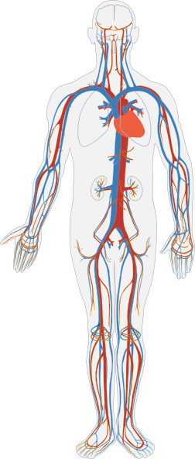
Levels of Organization
Organ
Systems
A group of organs that work together to perform certain functions
Examples: circulatory system (blood, heart, lungs, etc.) and nervous system (brain, nerves, spinal cord, etc.)
Notes:
Heart image found at http://scjenkinsart.files.wordpress.com/2011/02/heart-graphic.jpg, Circulatory System image found at http://www.clker.com/cliparts/3/U/t/k/4/o/circulatory-system-no-labels-hi.png

Slide 15
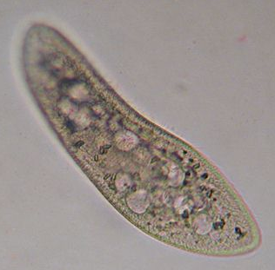
Levels of Organization
Organisms
A living thing that can carry out all life processes
Most complex level of organization
Some organisms are made of only one cell (like bacteria & paramecium)
Notes:
Circulatory System image found at http://www.clker.com/cliparts/3/U/t/k/4/o/circulatory-system-no-labels-hi.png, Person image found at http://www.illustrationsof.com/royalty-free-boy-clipart-illustration-37090.jpg, paramecium image found at http://www.microscope-microscope.org/gallery/Mark-Simmons/images/paramecium2.jpg, Tree image found at http://gallery.yopriceville.com/var/albums/Free-Clipart-Pictures/Trees-PNG-Clipart/Green_Painted_Tree_PNG_Clipart.png, mushroom picture found at http://fc02.deviantart.net/fs37/f/2008/284/5/9/Mushroom_Madness_8_by_Dracoart_Stock.jpg, Bacteria image found at http://themindfulfoodie.com/wp-content/uploads/2012/09/bacteria.jpg, Bird image found at http://1.bp.blogspot.com/-oenpSnKmkRI/Twgc0bwSErI/AAAAAAAAARg/hWWG9IGPKIk/s640/8aug11galahs2sturtNP+%2528180%2529.jpg

Slide 16
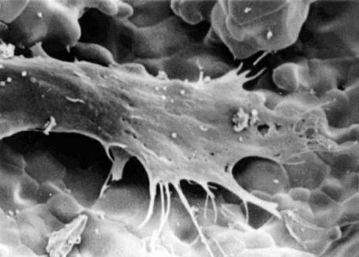
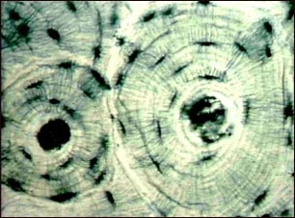
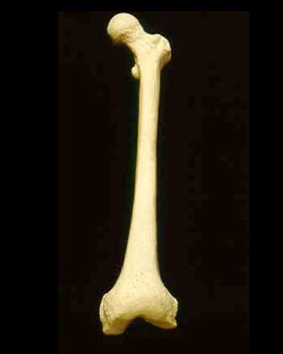
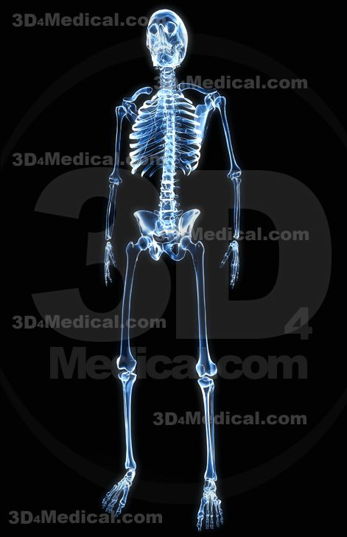
The levels of organization from simplest to most complex are:
Cells
Tissues
Organs
System
Organism

Slide 17
Let’s Review….
1st Level: Cells working together form
2nd Level: Tissues, which can form
3rd Level: Organs, which work together to form
4th Level: Organ Systems, which work together to form
5th Level: Organisms!

Slide 18
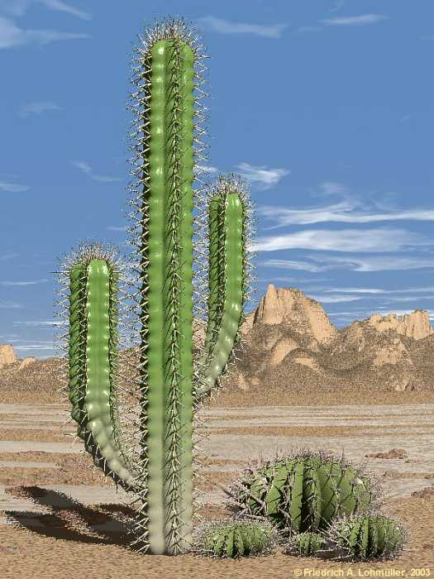
A cell, tissue, organ, system, or organism?
Found: Cacti are often found in desert environments
Function: to live and survive in its environment
ORGANism
Notes:
Cactus picture found at http://www.himhministries.com/uploads/2/5/6/8/25688620/3168713_orig.jpg

Slide 19
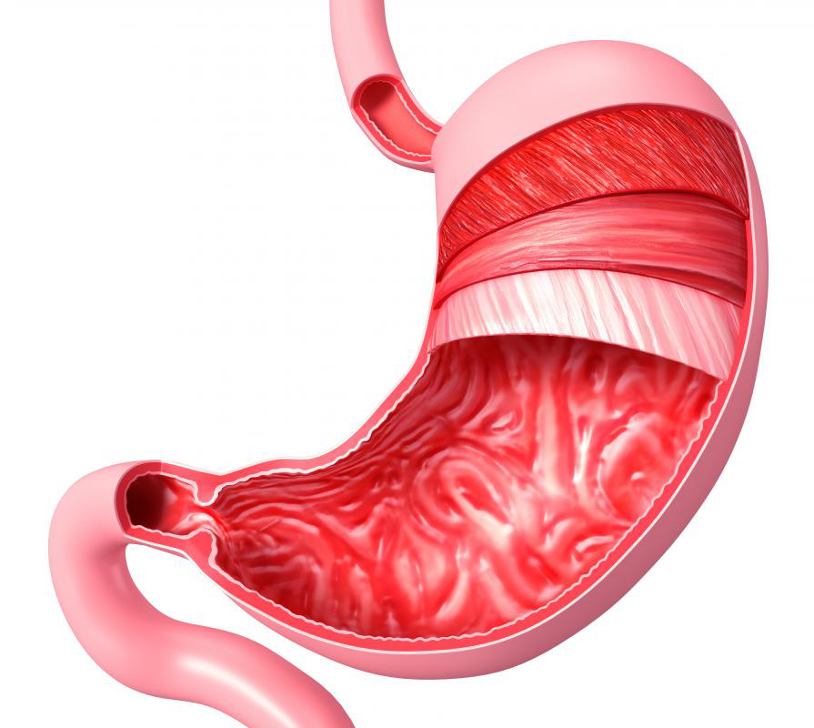
A cell, tissue, organ, system, or organism?
Found: the stomach is part of the digestive tract in many animals
Function: to break down food, and store it to later be absorbed by the intestines
ORGAN
Notes:
Stomach picture found at http://www.newhopemedicalcenter.com/wp-content/uploads/2012/06/stomach.jpg

Slide 20
A cell, tissue, organ, system, or organism?
Found: the circulatory system is in the human body, as well as many other organisms
Function: It transports oxygen and sugar to all cells within the body
SYSTEM
Notes:
Circulatory System image found at http://www.clker.com/cliparts/3/U/t/k/4/o/circulatory-system-no-labels-hi.png

Slide 21
A cell, tissue, organ, system, or organism?
Found: These are various layers of cells found inside the human body
*epithelial
*nervous
*muscle
*connective
Function: Each of these has its own function, what do you think they are?
TISSUE
Notes:
Tissue picture found at http://editions.sciencetechnologyaction.com/lessons/3/47/fig1.jpg

Slide 22
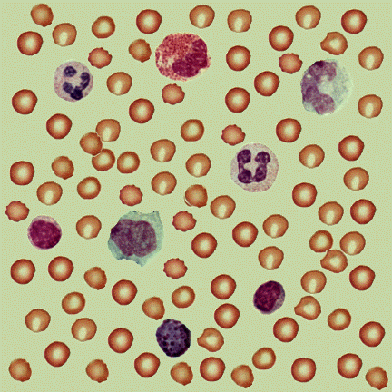
A cell, tissue, organ, system, or organism?
Found: these are different types of red and white blood cells found in our blood
Function: red blood cells transport oxygen to other body parts, white blood cells fight off diseases
What level is our blood?
CELLS
Notes:
Blood cells image found at http://textbookofbacteriology.net/Blood.gif

Slide 23
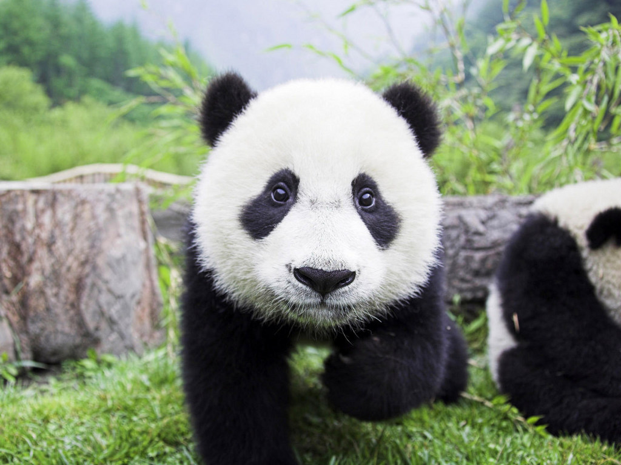
A cell, tissue, organ, system, or organism?
Found: in China
Function: to live and survive in the wild
ORGANISM
Notes:
Panda picture found at http://www.mlmguides.com/wp-content/uploads/2011/09/panda-bear1.jpg

Slide 24
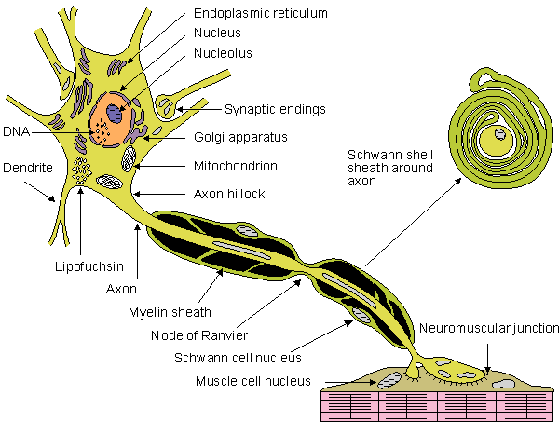
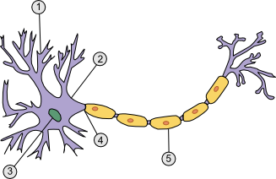
A cell, tissue, organ, system, or organism?
Found: in our brain, our nervous tissue is made up of millions of these
Function: neurons transmit signals to body parts to tell them what to do
CELLS
Notes:
Nerve cell images found at http://www.sciencegeek.net/Biology/review/graphics/Unit8/neuron.png and http://upload.wikimedia.org/wikipedia/en/e/e9/Nerve_cells.gif

Slide 25
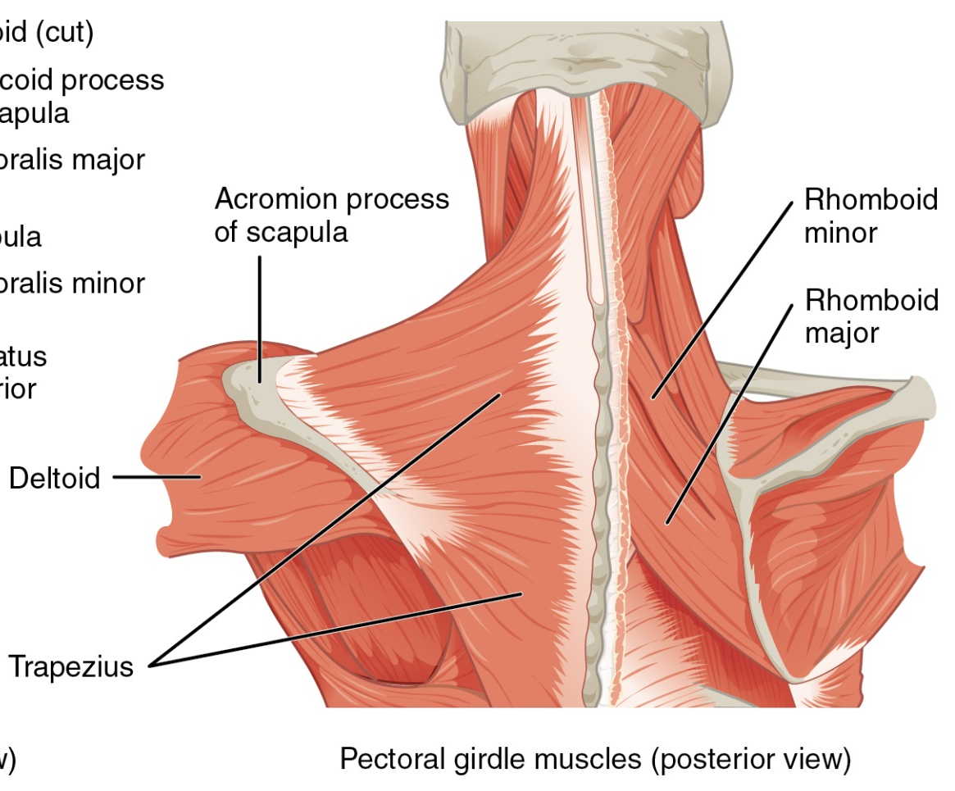
A cell, tissue, organ, system, or organism?
Found: All over our bodies
Function: muscles help us to move, pump blood, and support our skeleton
TISSUES
Notes:
Muscle image found at http://cnx.org/content/m46495/latest/1118_Muscles_that_Position_the_Pectoral_Girdle.jpg

Slide 26
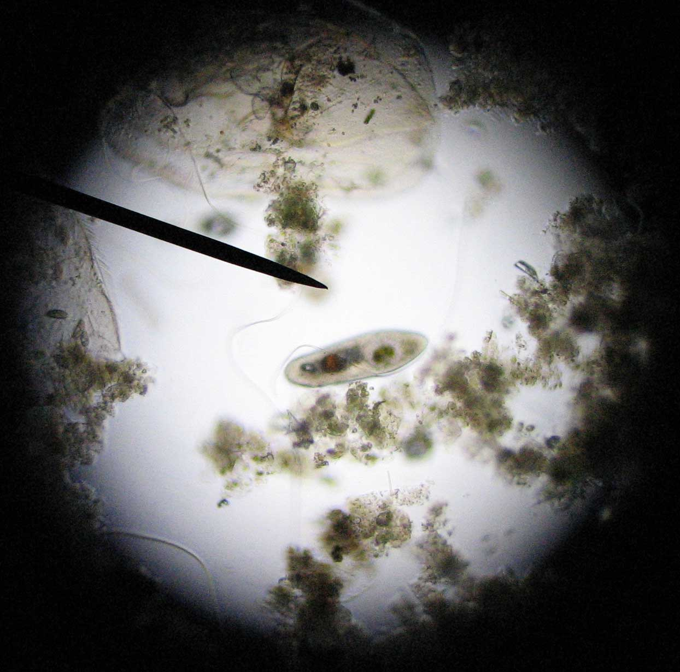
A cell, tissue, organ, system, or organism?
Found: paramecium are often found in pond water
Function: to live and survive in their environment
ORGANISM
Notes:
Paramecium image found at http://www.artscape.us/aquaculture/paramecium/paramecium_0035.jpg

Slide 27
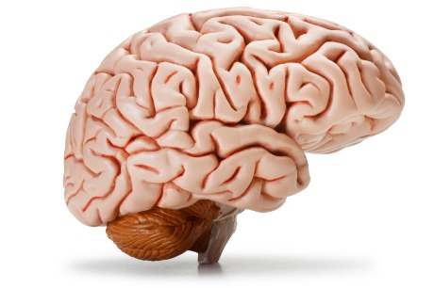
A cell, tissue, organ, system, or organism?
Found: Found in many animals as part of the nervous system
Function: sends and receives signals throughout the body
ORGAN
Notes:
Brain Image found at http://www.nuffieldfoundation.org/sites/default/files/images/brain.jpg

Slide 28
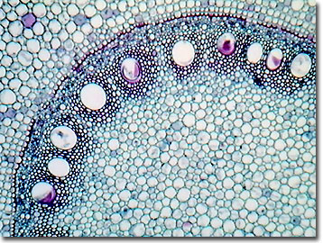
A cell, tissue, organ, system, or organism?
Found: Corn stem tissue can be found in the root tips of corn plants
Function: Helps send water & other nutrients to various parts of the plant
Tissue
Notes:
Corn Stem Tissue Image found at http://micro.magnet.fsu.edu/optics/olympusmicd/galleries/brightfield/images/cornstemlow.jpg

Slide 29
A cell, tissue, organ, system, or organism?
Found: The Maple leaf is found on branches of Maple Trees
Function: Made of many layers of various tissues, maple leaves are vital in using energy from the sunlight to make food (photosynthesis)
Organ
Notes:
Maple Leaf Image found at http://upload.wikimedia.org/wikipedia/commons/c/c6/Freeman_maple_leaf.jpg

Slide 30
Levels of Organization Video

Slide 31
Science Closure 1/4/2021
What are the 5 levels of Organization of Life from smallest to largest?

