Slide 1
Homeroom Warm Up 11/18/19
November 18th is Mickey Mouse’s birthday. Since his creation, Mickey Mouse has become one of the most famous cartoon characters. If you could create a friend for Mickey Mouse, what type of character would you create?

Slide 2
Science Warm Up 11/18/19
In which of the following kingdoms would you find unicellular organisms that do NOT have nuclei?
a. Fungi
b. Archaebacteria
c. Protist
d. None of the above

Slide 3
Don’t Forget
Kingdom’s of Life Webquest is due today. Put it into your class tray at back before leaving.
All projects that are not placed on display must be taken home by tomorrow Tuesday 11/19/19.

Slide 4
Homework due this Wed
Textbook pages 189-199. Define all vocabulary terms listed on page 189 on graphing pages providing in textbook behind page 199.
These pages should’ve been started in class last week after test.

Slide 5
Levels of Organization
7th Grade Science

Slide 6
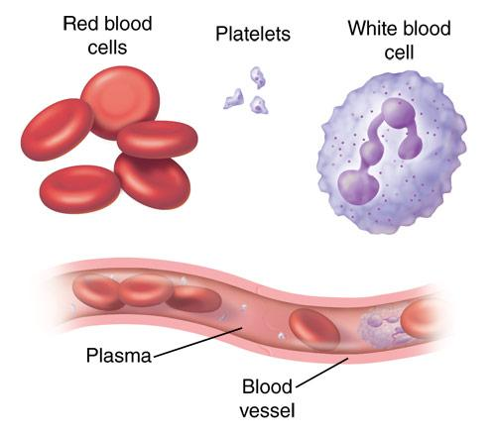
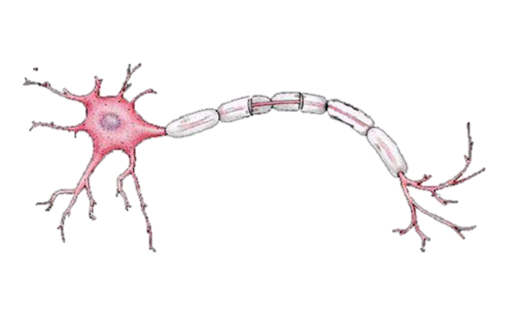
Levels of Organization
CELLS
The basic unit of structure & function of all living things
Most simple level of organization
Examples: Red Blood Cells, Nerve Cells

Slide 7
Levels of Organization
TISSUES
A group of cells connected together that all do the same thing
Examples: muscle tissue, epithelial tissue, nervous tissue, & connective tissue

Slide 8
Levels of Organization
TISSUES
A group of cells connected together that all do the same thing
Examples: muscle tissue, epithelial tissue, nervous tissue, & connective tissue

Slide 9
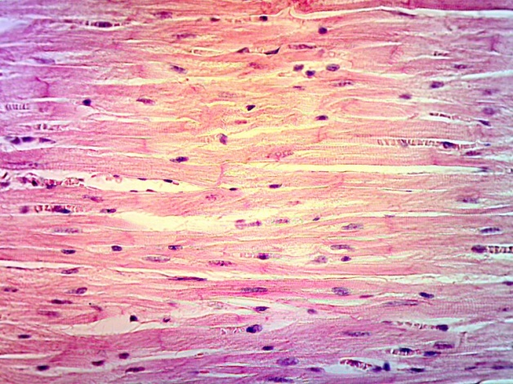
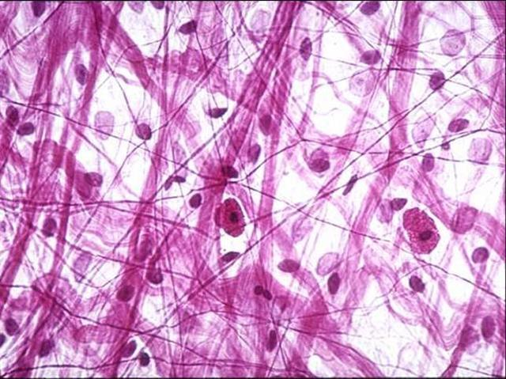
Levels of Organization
TISSUES
A group of cells connected together that all do the same thing
Examples: muscle tissue, epithelial tissue, nervous tissue, & connective tissue

Slide 10
Levels of Organization
OrganS
A group of tissues layered together that all work together to do the same thing
Examples: heart, liver, brain, skin

Slide 11
Levels of Organization
OrganS
A group of tissues layered together that all work together to do the same thing
Examples: heart, liver, brain, skin

Slide 12
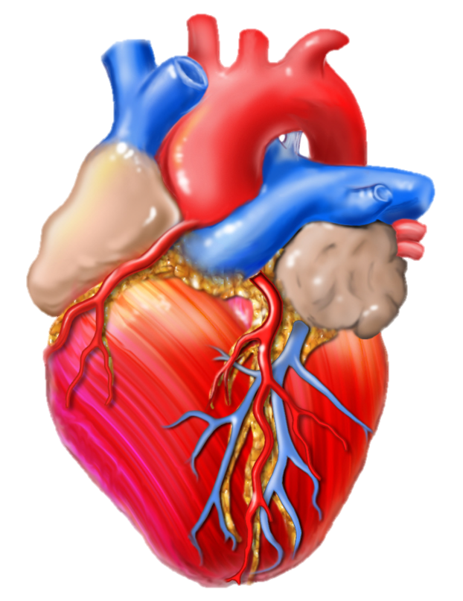
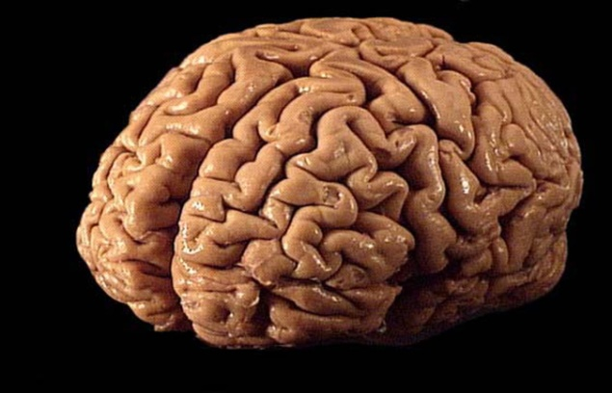
Levels of Organization
OrganS
A group of tissues layered together that all work together to do the same thing
Examples: heart, liver, brain, skin
Notes:
Heart image found at http://scjenkinsart.files.wordpress.com/2011/02/heart-graphic.jpg

Slide 13
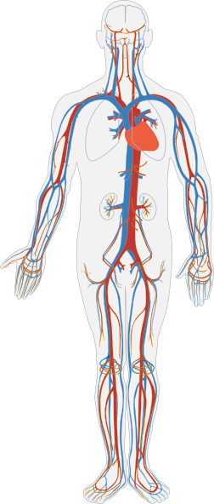
Levels of Organization
Organ
Systems
A group of organs that work together to perform certain functions
Examples: circulatory system (blood, heart, lungs, etc.) and nervous system (brain, nerves, spinal cord, etc.)
Notes:
Heart image found at http://scjenkinsart.files.wordpress.com/2011/02/heart-graphic.jpg, Circulatory System image found at http://www.clker.com/cliparts/3/U/t/k/4/o/circulatory-system-no-labels-hi.png

Slide 14
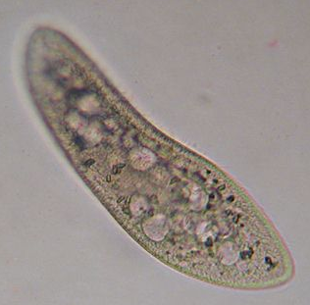
Levels of Organization
Organisms
A living thing that can carry out all life processes
Most complex level of organization
Some organisms are made of only one cell (like bacteria & paramecium)
Notes:
Circulatory System image found at http://www.clker.com/cliparts/3/U/t/k/4/o/circulatory-system-no-labels-hi.png, Person image found at http://www.illustrationsof.com/royalty-free-boy-clipart-illustration-37090.jpg, paramecium image found at http://www.microscope-microscope.org/gallery/Mark-Simmons/images/paramecium2.jpg, Tree image found at http://gallery.yopriceville.com/var/albums/Free-Clipart-Pictures/Trees-PNG-Clipart/Green_Painted_Tree_PNG_Clipart.png, mushroom picture found at http://fc02.deviantart.net/fs37/f/2008/284/5/9/Mushroom_Madness_8_by_Dracoart_Stock.jpg, Bacteria image found at http://themindfulfoodie.com/wp-content/uploads/2012/09/bacteria.jpg, Bird image found at http://1.bp.blogspot.com/-oenpSnKmkRI/Twgc0bwSErI/AAAAAAAAARg/hWWG9IGPKIk/s640/8aug11galahs2sturtNP+%2528180%2529.jpg

Slide 15
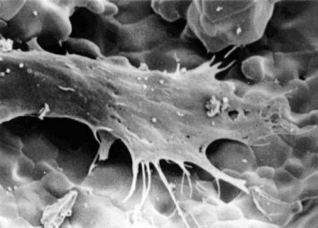
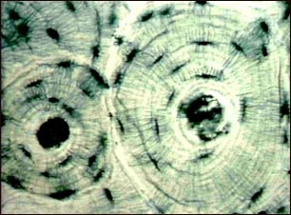
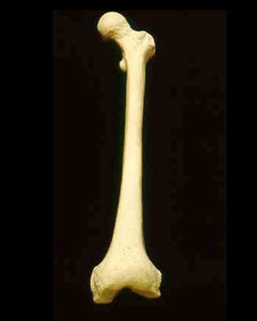
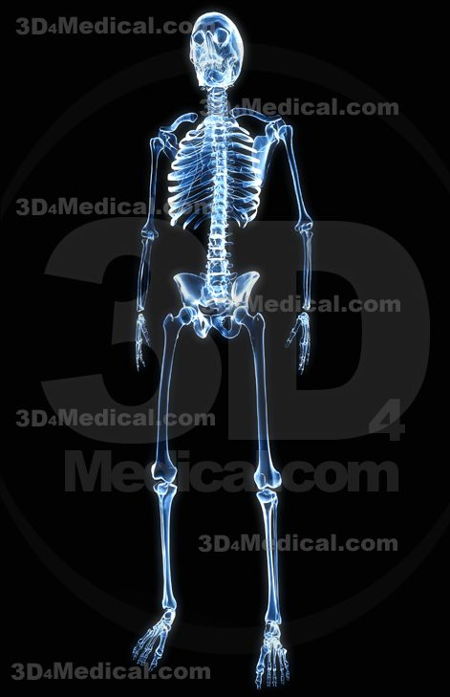
The levels of organization from simplest to most complex are:
Cells
Tissues
Organs
System
Organism

Slide 16
Let’s Review….
1st Level: Cells working together form
2nd Level: Tissues, which can form
3rd Level: Organs, which work together to form
4th Level: Organ Systems, which work together to form
5th Level: Organisms!

Slide 17
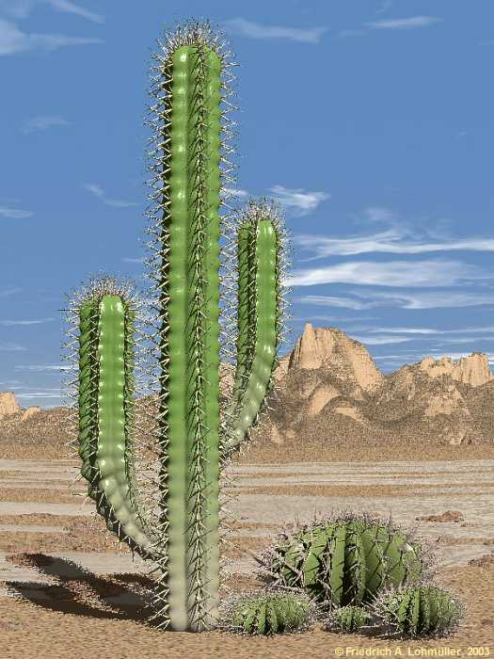
A cell, tissue, organ, system, or organism?
Found: Cacti are often found in desert environments
Function: to live and survive in its environment
ORGANism
Notes:
Cactus picture found at http://www.himhministries.com/uploads/2/5/6/8/25688620/3168713_orig.jpg

Slide 18
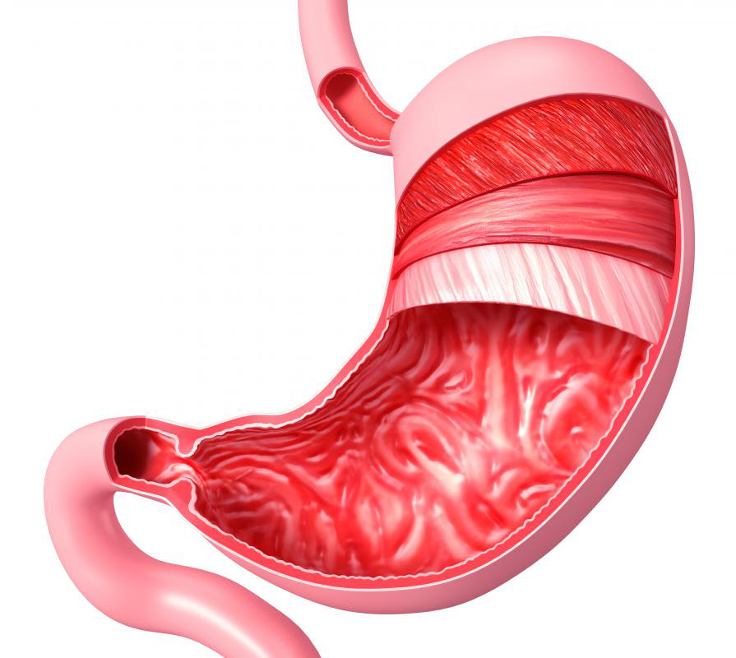
A cell, tissue, organ, system, or organism?
Found: the stomach is part of the digestive tract in many animals
Function: to break down food, and store it to later be absorbed by the intestines
ORGAN
Notes:
Stomach picture found at http://www.newhopemedicalcenter.com/wp-content/uploads/2012/06/stomach.jpg

Slide 19
A cell, tissue, organ, system, or organism?
Found: the circulatory system is in the human body, as well as many other organisms
Function: It transports oxygen and sugar to all cells within the body
SYSTEM
Notes:
Circulatory System image found at http://www.clker.com/cliparts/3/U/t/k/4/o/circulatory-system-no-labels-hi.png

Slide 20
A cell, tissue, organ, system, or organism?
Found: These are various layers of cells found inside the human body
*epithelial
*nervous
*muscle
*connective
Function: Each of these has its own function, what do you think they are?
TISSUE
Notes:
Tissue picture found at http://editions.sciencetechnologyaction.com/lessons/3/47/fig1.jpg

Slide 21
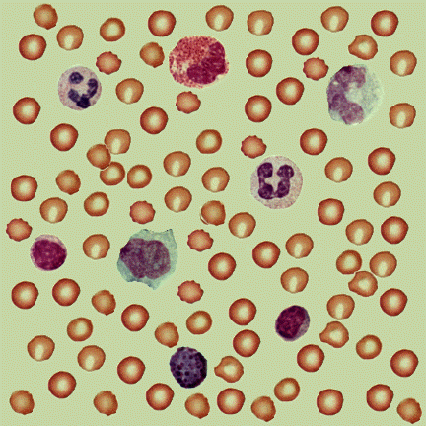
A cell, tissue, organ, system, or organism?
Found: these are different types of red and white blood cells found in our blood
Function: red blood cells transport oxygen to other body parts, white blood cells fight off diseases
What level is our blood?
CELLS
Notes:
Blood cells image found at http://textbookofbacteriology.net/Blood.gif

Slide 22
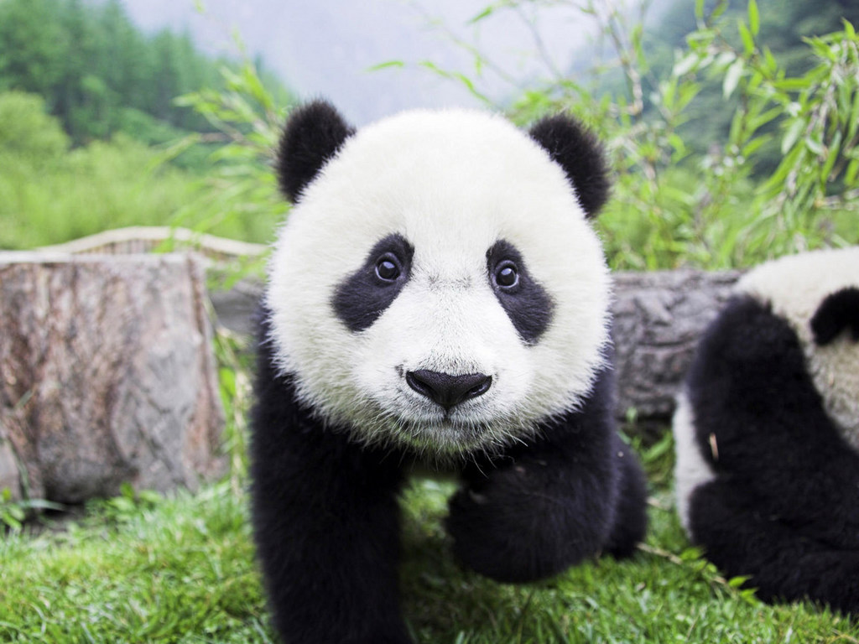
A cell, tissue, organ, system, or organism?
Found: in China
Function: to live and survive in the wild
ORGANISM
Notes:
Panda picture found at http://www.mlmguides.com/wp-content/uploads/2011/09/panda-bear1.jpg

Slide 23
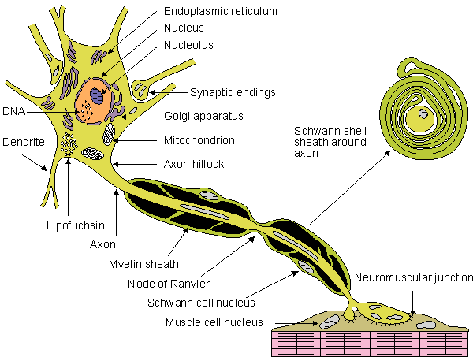
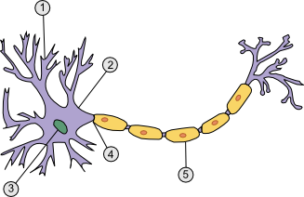
A cell, tissue, organ, system, or organism?
Found: in our brain, our nervous tissue is made up of millions of these
Function: neurons transmit signals to body parts to tell them what to do
CELLS
Notes:
Nerve cell images found at http://www.sciencegeek.net/Biology/review/graphics/Unit8/neuron.png and http://upload.wikimedia.org/wikipedia/en/e/e9/Nerve_cells.gif

Slide 24
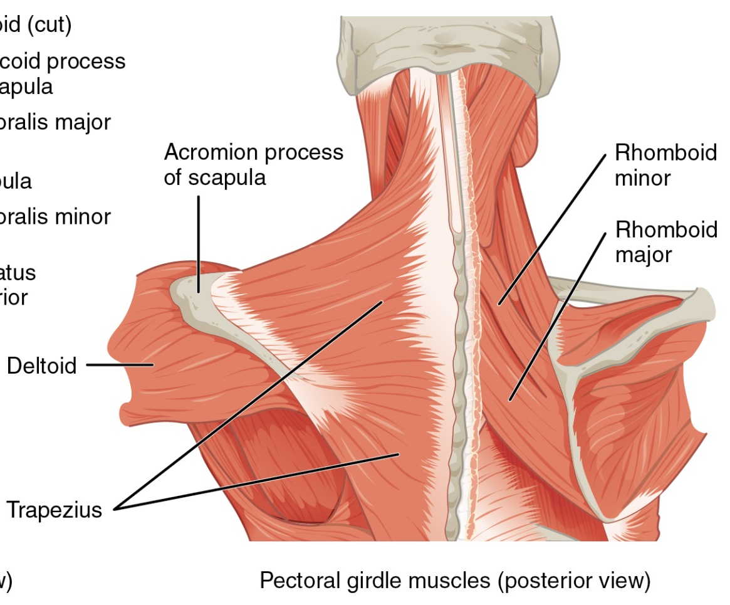
A cell, tissue, organ, system, or organism?
Found: All over our bodies
Function: muscles help us to move, pump blood, and support our skeleton
TISSUES
Notes:
Muscle image found at http://cnx.org/content/m46495/latest/1118_Muscles_that_Position_the_Pectoral_Girdle.jpg

Slide 25
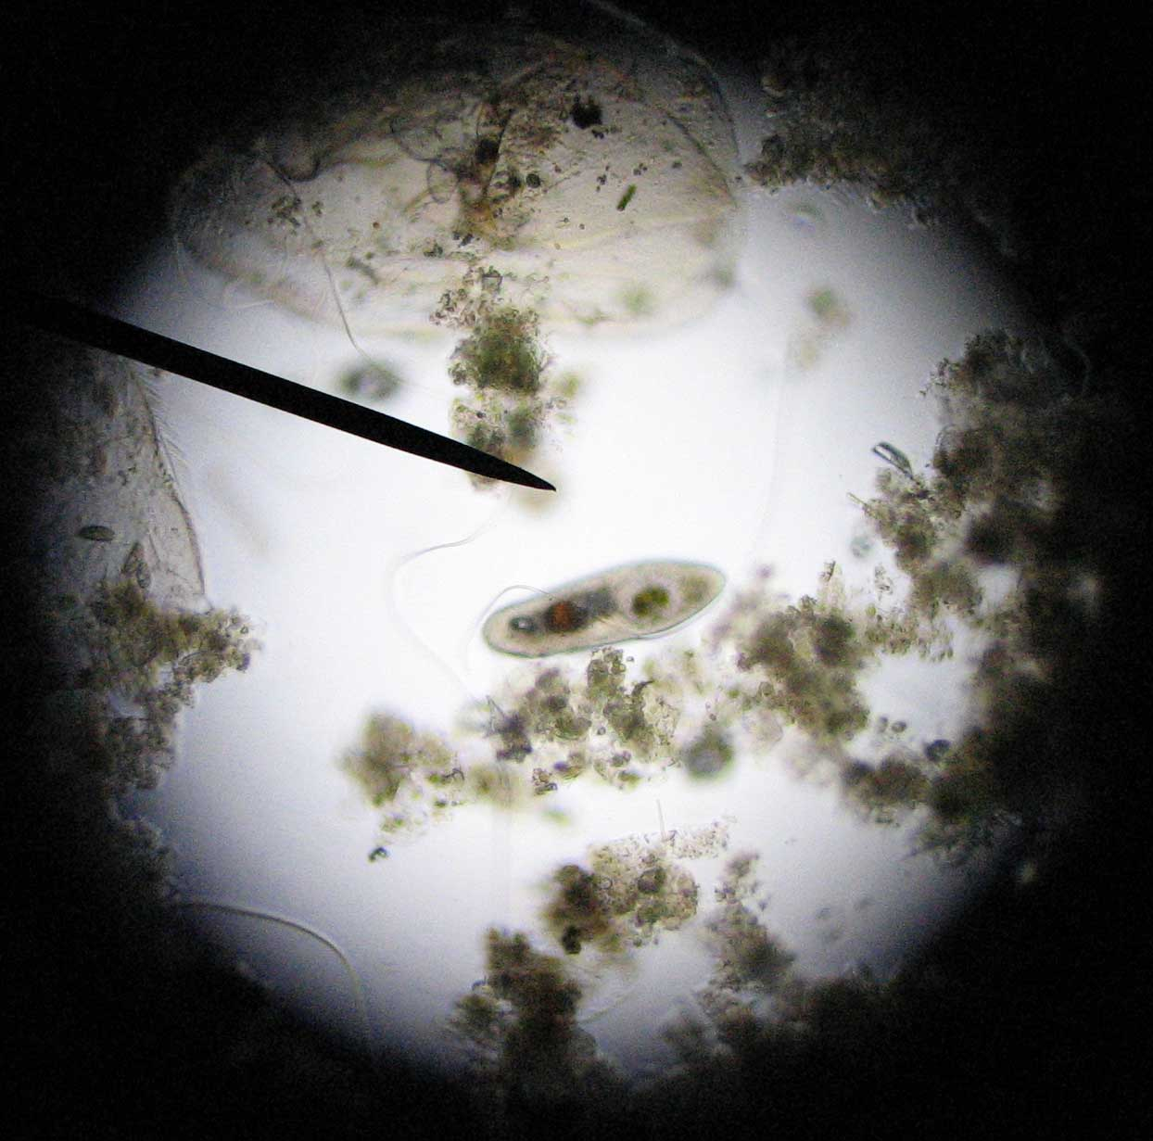
A cell, tissue, organ, system, or organism?
Found: paramecium are often found in pond water
Function: to live and survive in their environment
ORGANISM
Notes:
Paramecium image found at http://www.artscape.us/aquaculture/paramecium/paramecium_0035.jpg

Slide 26
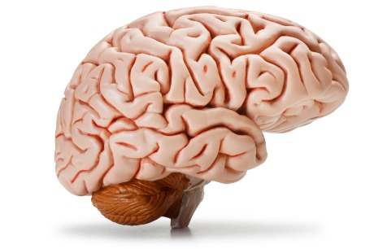
A cell, tissue, organ, system, or organism?
Found: Found in many animals as part of the nervous system
Function: sends and receives signals throughout the body
ORGAN
Notes:
Brain Image found at http://www.nuffieldfoundation.org/sites/default/files/images/brain.jpg

Slide 27
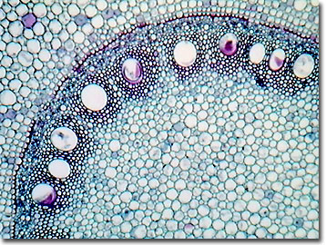
A cell, tissue, organ, system, or organism?
Found: Corn stem tissue can be found in the root tips of corn plants
Function: Helps send water & other nutrients to various parts of the plant
Tissue
Notes:
Corn Stem Tissue Image found at http://micro.magnet.fsu.edu/optics/olympusmicd/galleries/brightfield/images/cornstemlow.jpg

Slide 28
A cell, tissue, organ, system, or organism?
Found: The Maple leaf is found on branches of Maple Trees
Function: Made of many layers of various tissues, maple leaves are vital in using energy from the sunlight to make food (photosynthesis)
Organ
Notes:
Maple Leaf Image found at http://upload.wikimedia.org/wikipedia/commons/c/c6/Freeman_maple_leaf.jpg

Slide 29
Science Closure 11/18/19
What are the 5 levels of Organization of Life from smallest to largest?

