Slide 1
Vocabulary Terms
Homeostasis
System
Digestive System
Respiratory System
Excretory System
Circulatory System
Nervous System
Muscular System
Skeletal System

Slide 2
Human Body Systems

Slide 3
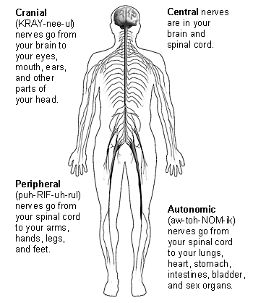
Nervous System
Functions
Controls all body’s functions
Senses and recognizes information from inside and outside of the body

Slide 4
Nervous System
Main Parts
Brain
Nerves
Spinal cord

Slide 5
What it helps you do…
Move
Sense things from the environment
And much more!

Slide 6
Interactions with other systems:
All systems – helps keep the systems functioning

Slide 7
Skeletal System
Support and protect body parts.
Helps maintain homeostasis
Makes red blood cells (red bone marrow)

Slide 8
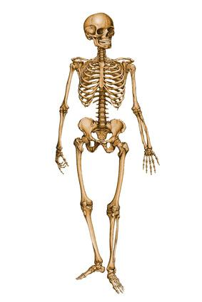
Skeletal System: Parts & Function
Main parts:
Bones
Cartilage
Connective Tissue
Function:
Helps support your body parts
Helps support your body during movement
Helps protect your major organs:
Skull protects the brain
Sternum and ribs protects the heart and lungs
Vertebra protect the spinal cord

Slide 9
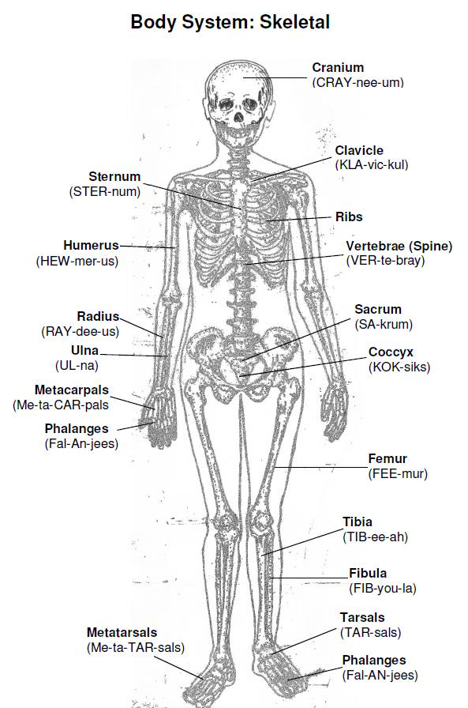
Skeletal System Interactions
Works with the muscular system to help you move.

Slide 10
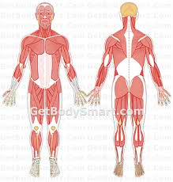
Muscular System
Function
Helps you move.
Moves materials through the body
Main parts
Muscles
Tendons
Ligaments
Muscles in organs

Slide 11
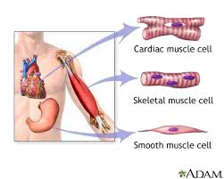
Three types of muscles found in the body:
Cardiac
Skeletal
Smooth

Slide 12
Muscular Systems help you…
Helps you move
Helps you move materials through the body
Maintain homeostasis
Skeletal muscles work in pairs: one contracts and the other returns to its original length.

Slide 13
Interactions with other systems
Works with the skeletal system to help you move by your muscles pulling on your bones.
Works with the nervous system and controls the types of movements: voluntary (under your control – ex: talking) and involuntary (NOT under your control – ex: heartbeat)

Slide 14
Circulatory (Cardiovascular) System
Function
Carries blood and nutrients to the cells of the body
Carries waste away from the cells, such as carbon dioxide.
Main Parts
Heart
Blood (made up of plasma, red blood cells, white blood cells & platelets)
Veins
Arteries

Slide 15
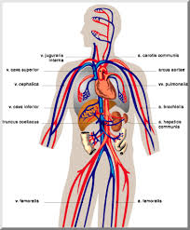
What it helps you do…
Arteries help carry oxygenated blood away from the heart
Veins carry un-oxygenated blood toward the heart
Capillaries are tiny blood vessels that connect arteries and veins. Gas exchange takes place here.

Slide 16
Interactions with other systems:
Works with the respiratory system to help you transport oxygen and carbon dioxide.
Works with the excretory to help remove waste from the body.
Works with the digestive system to transport nutrients.
Works with the muscular system to help circulate nutrients.

Slide 17
Respiratory System
Function
Puts oxygen into the body & removes Carbon dioxide
Main parts
Lungs
Nasal passages
Throat
Nose

Slide 18
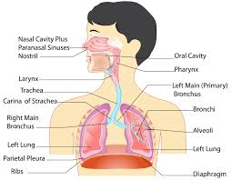
What it helps you do…
Breathe
Sustain life

Slide 19
Interactions with other systems:
Circulatory – transports vital materials to the cells

Slide 20
Digestive System
Function
Takes food & breaks it down into nutrients the body needs

Slide 21
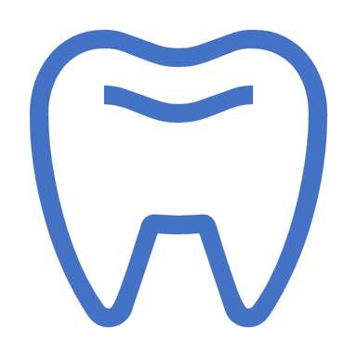
Digestive System
Main parts:
Mouth
Stomach
Liver
Pancreas
Small intestines
Large intestines

Slide 22
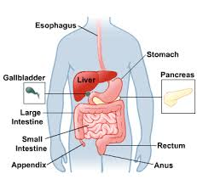
What it helps you do…
It provides nutrients to your body’s cells

Slide 23
Interactions with other systems:
Circulatory – helps transport nutrients to the body’s cells

Slide 24
Excretory System
Functions
Removes wastes from blood
Removes harmful substances from blood
Regulates body fluids

Slide 25
Excretory System
Main Parts
Kidneys
Urinary bladder

Slide 26
What it helps you do…
Maintain homeostasis
Removes waste

Slide 27
What system does it interact with:
Circulatory – to help remove waste from the blood

Slide 28
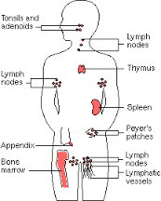
Immune/ Lymphatic System
Functions
Fights off disease

Slide 29
Immune/ Lymphatic System
Main Parts
Lymph nodes
White blood cells
Skin

Slide 30
What it helps you do…
Maintain a healthy body

Slide 31
Interactions with other systems:
Circulatory, integumentary, lymphatic – helps fight diseases

Slide 32
Reproductive System
Endocrine System
Functions
Produces offspring
Continuation of the species
Functions
controls many body processes by means of chemical messages, like hormones.

Slide 33
What it helps you do…
Continuation of the species

Slide 34
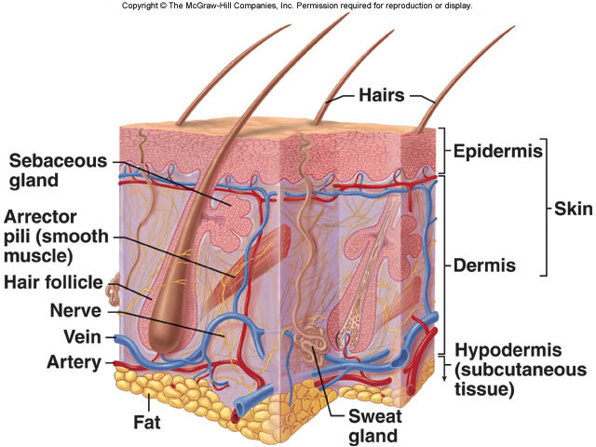
Integumentary (Skin) System
Function
1st line of defense against disease
Helps maintain body temperature
Keeps fluids inside
Main Parts
Skin
Sweat glands
Hair
nails

Slide 35
What it helps you do…
Helps you maintain fluids (don’t dehydrate)
Helps you know your environment by feeling things around you
Protect organs
Remove waste

Slide 36
Science Closure 1/8/2021
The main function of which system is to help protect inner organs from being damaged by an outside force?
A excretory
B nervous
C skeletal
D circulatory

