Slide 1
Homeroom Warm Up 12/18/19
What is your favorite holiday tradition? What do you love most about it?

Slide 2
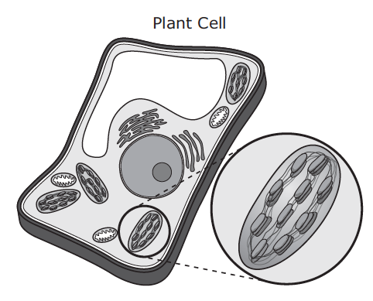
Science Warm Up 12/18/19
A diagram of a plant cell is shown. The function of the plant cell structure shown in the enlargement is to
A. provide support for the cell.
B. direct all the cell’s activities.
C. use energy from sunlight to make sugar.
D. regulate substances that enter and exit the cell

Slide 3
Outline for test → Test will be tomorrow If you are absent tomorrow you will take the test your next school day.
What is Diffusion? Be able to recognize examples of diffusion
What is Osmosis? Be able to recognize examples of osmosis
What is Passive and Active Transport? Be able to recognize examples of each
What is Endocytosis and Exocytosis?
Be able to determine the direction of particle movement when given and example.
Expect 20 multiple choice questions

Slide 4
Technology and Life Science
Objective→ I can identify how technology is applied to living organisms.

Slide 5
What Is Technology
Technology refers to the products and processes that are designed to serve our needs.
How Does Science Relate to Technology?
Engineering uses scientific knowledge to develop technologies.
The engineering design process has similarities to the scientific method.
Notes:
Header – dark yellow 24 points Arial Bold
Body text – white 20 points Arial Bold, dark yellow highlights
Bullets – dark yellow
Copyright – white 12 points Arial
Size:
Height: 7.52"
Width: 10.02"
Scale: 70%
Position on slide:
Horizontal - 0"
Vertical - 0"

Slide 6
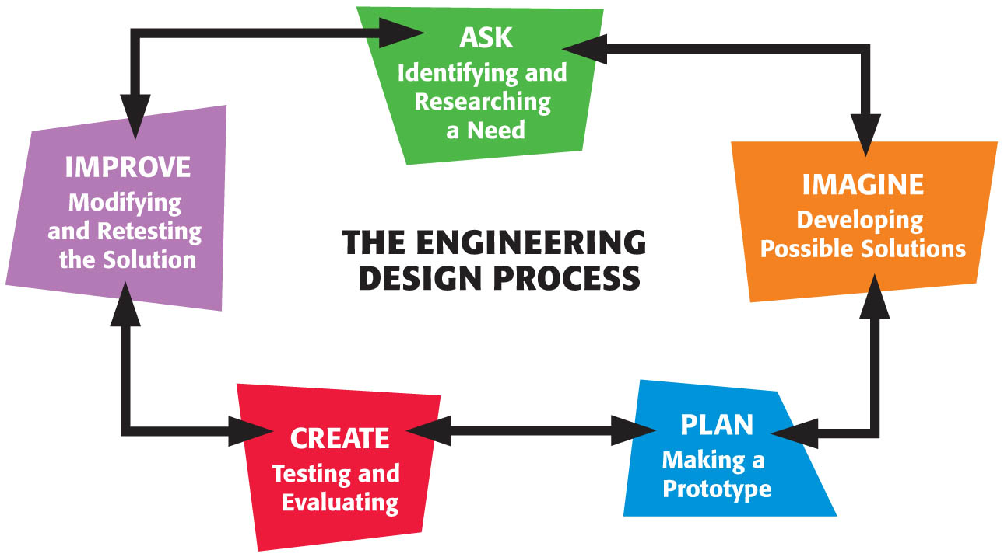
Science and Engineering
Notes:
Header – dark yellow 24 points Arial Bold
Body text – white 20 points Arial Bold, dark yellow highlights
Bullets – dark yellow
Copyright – white 12 points Arial
Size:
Height: 7.52"
Width: 10.02"
Scale: 70%
Position on slide:
Horizontal - 0"
Vertical - 0"

Slide 7
Science and Engineering
What is the Engineering Design Process? continued
Step 1 Ask: Identifying and Researching a Need
Engineers define and write the need or problem they are trying to solve.
For example, the problem may be to make clothing that repels water so that explorers can work, even in Antarctica.
Research provide engineers with information for problem solving.
Notes:
Header – dark yellow 24 points Arial Bold
Body text – white 20 points Arial Bold, dark yellow highlights
Bullets – dark yellow
Copyright – white 12 points Arial
Size:
Height: 7.52"
Width: 10.02"
Scale: 70%
Position on slide:
Horizontal - 0"
Vertical - 0"

Slide 8
and Engineering
What is the Engineering Design Process? continued
Step 2 Imagine: Developing Possible Solutions
Brainstorming is the process in which a group of people share ideas quickly to promote additional ideas.
Sometimes a possible solution to the problem comes from these ideas or it may take more time and thought.
Notes:
Header – dark yellow 24 points Arial Bold
Body text – white 20 points Arial Bold, dark yellow highlights
Bullets – dark yellow
Copyright – white 12 points Arial
Size:
Height: 7.52"
Width: 10.02"
Scale: 70%
Position on slide:
Horizontal - 0"
Vertical - 0"

Slide 9
Step 3 Plan: Making a prototype
A prototype is a test model of the product.
Prototypes allow engineers to see if their design works the way they expect it to.

Slide 10
Section 4 Science and Engineering
What is the Engineering Design Process? continued
Step 4 Create: Testing and Evaluating
Prototypes are tested and evaluated.
Engineers complete a cost-benefit analysis to make sure that the cost of designing and producing the new product is worth its benefit.
For example, it may only makes sense to produce a new product if it is not too expensive to produce.
Notes:
Header – dark yellow 24 points Arial Bold
Body text – white 20 points Arial Bold, dark yellow highlights
Bullets – dark yellow
Copyright – white 12 points Arial
Size:
Height: 7.52"
Width: 10.02"
Scale: 70%
Position on slide:
Horizontal - 0"
Vertical - 0"

Slide 11
Section 4 Science and Engineering
What is the Engineering Design Process? continued
Step 5 Improve: Modifying and Retesting the Solution
If a prototype was not successful or did not work well, engineers would either modify their prototype or try a new solution.
It is important that the engineers consider what was learned from the first prototype before they begin the design process again.
Notes:
Header – dark yellow 24 points Arial Bold
Body text – white 20 points Arial Bold, dark yellow highlights
Bullets – dark yellow
Copyright – white 12 points Arial
Size:
Height: 7.52"
Width: 10.02"
Scale: 70%
Position on slide:
Horizontal - 0"
Vertical - 0"

Slide 12
ence and Engineering
What is the Engineering Design Process? continued
Communication Engineers often need to share their successes, failures, and reasoning with others.
Engineers may explain and promote the technology to customers, or they may communicate with the public through news releases, advertisements, or journals.
Notes:
Header – dark yellow 24 points Arial Bold
Body text – white 20 points Arial Bold, dark yellow highlights
Bullets – dark yellow
Copyright – white 12 points Arial
Size:
Height: 7.52"
Width: 10.02"
Scale: 70%
Position on slide:
Horizontal - 0"
Vertical - 0"

Slide 13
Science and Engineering
Technology and Society
Technology provides solutions for many types of social, political, and economic needs.
Intended Benefit An intended benefit is the positive purpose for which a technology is designed to be used.
Unintended Consequences Unintended consequences are uses or results that engineers do not purposely include in the design of products. An unintended consequence can be beneficial.
Notes:
Header – dark yellow 24 points Arial Bold
Body text – white 20 points Arial Bold, dark yellow highlights
Bullets – dark yellow
Copyright – white 12 points Arial
Size:
Height: 7.52"
Width: 10.02"
Scale: 70%
Position on slide:
Horizontal - 0"
Vertical - 0"

Slide 14
Science and Engineering
Bioengineering
Bioengineering The application of engineering to living things, such as humans and plants, is called bioengineering.
2 types
1. Assistive technologies are developed to help organisms with changing them.
2. Adaptive bioengineered products change the living organism.
Notes:
Header – dark yellow 24 points Arial Bold
Body text – white 20 points Arial Bold, dark yellow highlights
Bullets – dark yellow
Copyright – white 12 points Arial
Size:
Height: 7.52"
Width: 10.02"
Scale: 70%
Position on slide:
Horizontal - 0"
Vertical - 0"

Slide 15
Engineering Design Process Notes Write notes in your Science Notebook
What is technology?
How does science relate to technology?
What is engineering?
What is the Engineering Design Process ?
5 steps of the Engineering Design Process
What is Bioengineering?
Two types Adaptive and Assistive. How are they different?
8. Intended Benefits and Unintended Consequences

Slide 16
Science Closure
Some scientists want to design a system of instruments that will evaluate ocean currents, temperatures, and winds in order to predict weather patterns. What should they do before they produce the first complete working version of the system?
A. build a prototype of the system
B. evaluate the results of the system
C. improve the design of the system
D. conduct tests on the system

