Slide 1
Homeroom Warm Up 9/18/2020
On this day in 1851, the New York Times newspaper was first published. Do you think it’s important for students your age to keep up on current events? Why or why not?

Slide 2
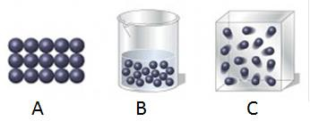
Science Warm Up 9/18/2020
If enough heat was REMOVED from B, it would change into .
A
Gas
C
Liquid

Slide 3
Outline for Matter Test Textbook pages 66-73
Warm Up- Write down test outline in notebook!
States of Matter – particle arrangements, particle motion and distance between particles. Be able to recognize examples.
2. Factors that determine state of matter (distance between particles, motion of particles and energy of particles)
3. Phase changes- be able to recognize examples of
a. evaporation
b. melting
c. freezing
d. condensation
e. sublimation
f. deposition

Slide 4
Objective
I can describe the 3 states of matter in order show each state is dependent upon 3 factors.

Slide 5
Our Lesson today is self paced
See assignment tab in teams and complete the 9/18/2020 Phase Change Virtual Lab (First click link to watch then video & then complete lab activity.
Complete exit ticket on Mastery Connect. Log in through Clever and Complete Matter Exit Ticket (No code required)
Matter Pretest Retake should be completed by 5 PM today! See Mastery Connect. See your class web chat for test code before you log out today.
2nd Period Code 519989
3rd Period Code 222853
4th Period Code 674588
5th Period Code 120284
6th Period Code 191464
7th Period Code 624272

