Slide 1

Homeroom Warm Up
9/21/2020
On this day in 1789, the United States Post Office opened. In recent years, many people have begun to use email. Do you think there will ever be a time in the future that the only items actually “mailed” by the Post Office are packages? And all letters and magazines will be sent via email?

Slide 2
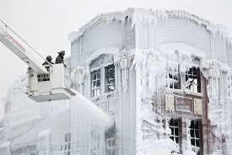
Science Warm Up
Write 3-5 complete sentences to explain what caused last week’s phenomenon

Slide 3

Homework
Read textbook pages 36-45 in Science Textbook. Only answer the questions that are on page 45!

Slide 4

Objective
I can compare and contrast the properties of matter in order to differentiate between physical and chemical changes.

Slide 5
Join me in Nearpod
See class posts for code!
Type your first and last name into Nearpod for grading purposes!

Slide 6
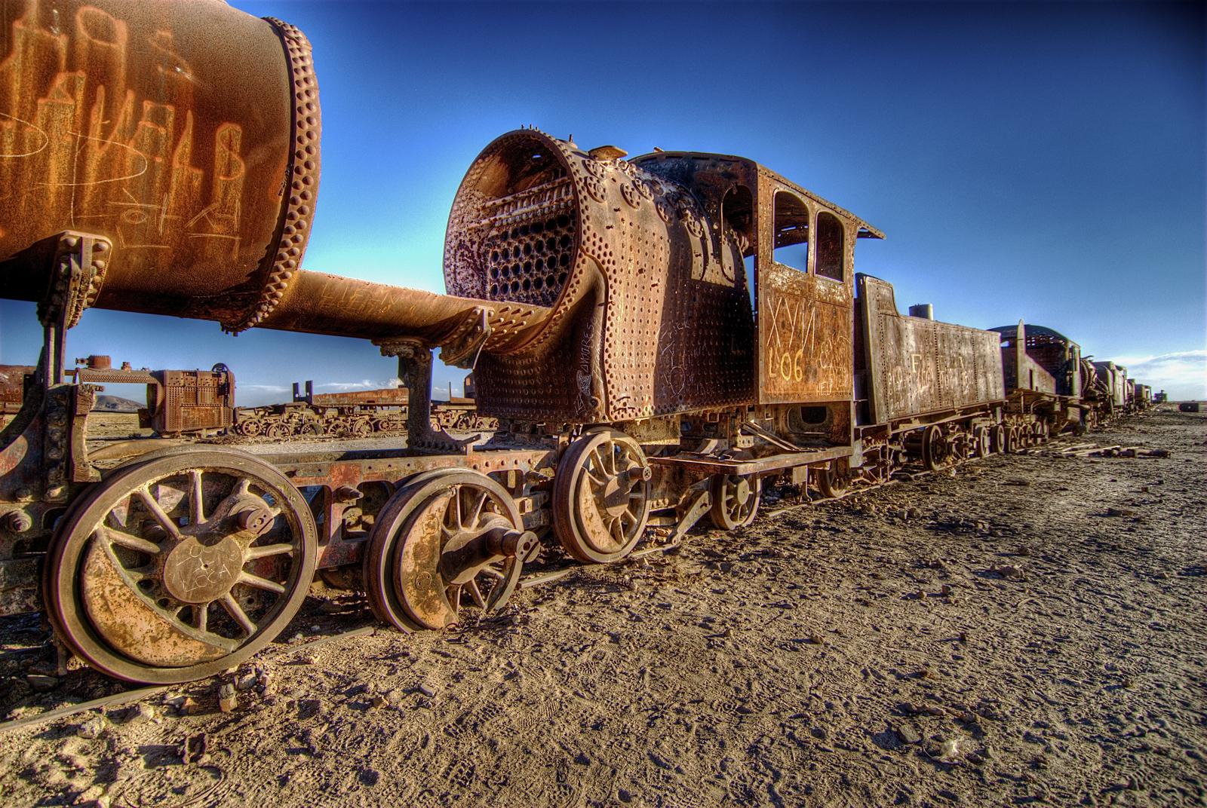
Take a look at the picture below and complete the following sentences with your own responses in your science notebook.
This makes me think of….
I wonder….
I have some questions….
This makes me want to….

Slide 7

Physical and Chemical Changes

Slide 8
Physical Properties
Physical property is a property that can be easily observed without changing the identity of the substance.
Examples:
viscosity
conductivity
malleability
hardness
magnetism
melting point
boiling point
density
color

Slide 9
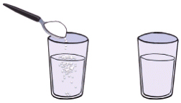
Examples of Physical Properties
A. Solubility of a substance is
its ability to dissolve.
Example: sugar in water
B. Conductivity is a material’s ability to allow heat or electricity to flow.
Examples: metal = high conductivity
wood = poor conductivity

Slide 10
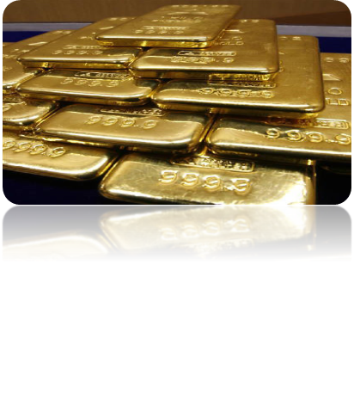
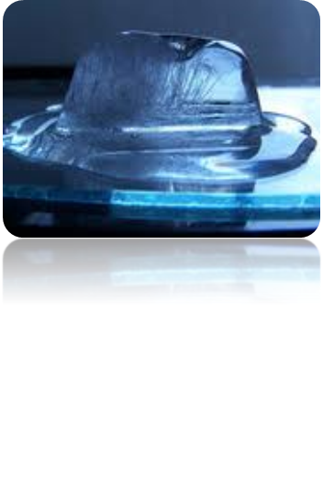
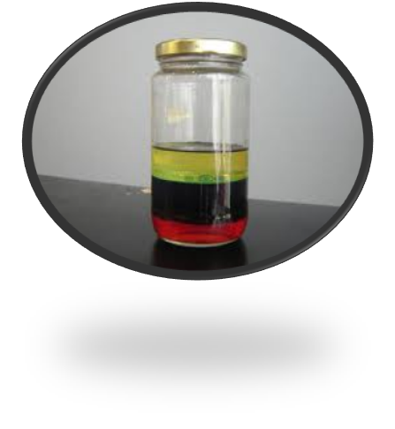
Examples of Physical Properties
C. Malleability of a substance is
its ability to be hammered into a thin sheet
D. Melting and Freezing points are the temperatures at which a solid becomes a liquid and a liquid becomes a solid.
E. Density of a substance is a measure of how close together its particles are.
Low density = float
High density = sink

Slide 11
Physical Change
A change in the appearance, without changing the identity of the material.
Can be reversible, or irreversible
Substance may seem different, but the way the atoms link up is the same.
It is a physical change if . . .
It changes shape or size
It dissolves.
Or the substance changes phase.

Slide 12
Chemical Properties
Chemical property is any ability to produce a change in the identity of matter.
Examples of chemical properties . . .
flammability
reactivity
Corrosive:
Eating away,
such as a
metal by acid
Material’s ability to burn in the presence of oxygen.
How readily a substance combines chemically with other substances.

Slide 13

Chemical Changes
Chemical changes occur when a substance reacts and forms one or more new substances.
You know a chemical change has occurred when there is. . .
A change in color or odor.
Production of a gas (bubbling).
Formation of a precipitate (solid).
Absorb or release energy (gets hot or cold or light is given off).

Slide 14
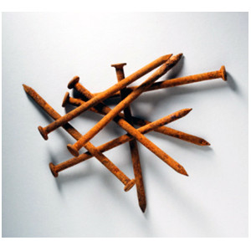

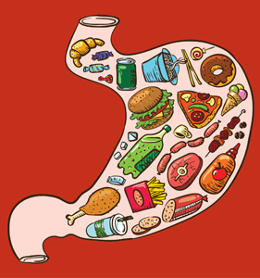
Examples of Chemical Changes:
Burning
Or Combustion:
Color change, odor change,
Produces a gas, gets hot
Rusting:
Color change
Corroding:
Color change
Digesting:
Color change, odor
Change, produces a
Gas, releases energy
Molding:
Color change
Decaying:
Color change

Slide 15

What kind of change is it?
A

Slide 16

What kind of change is it?
B

Slide 17
What kind of change is it?
C

Slide 18
What kind of change is it?
D

Slide 19

What kind of change is it?
E

Slide 20

What kind of change is it?
F

Slide 21
Physical
Chemical
A
C
D
F
B
E

Slide 22
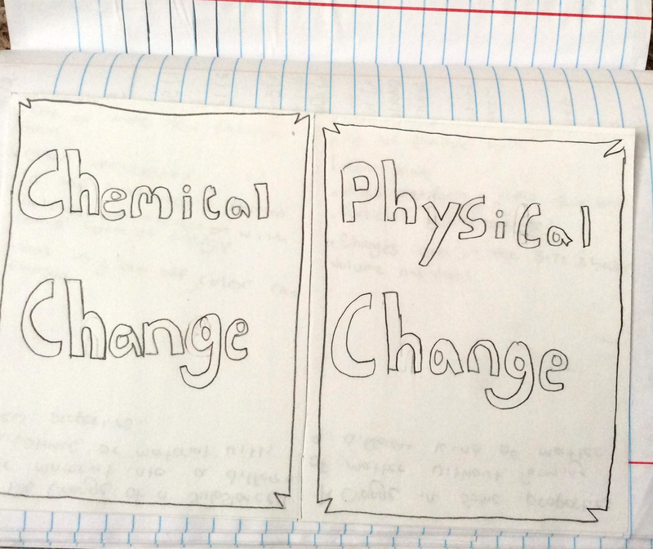
Create a foldable to compare
Chemical & Physical Changes

Slide 23
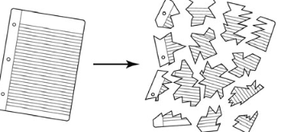
Science Closure
Marco tears a piece of notebook paper into
smaller pieces, as shown below. Tearing paper into pieces is an example of what kind of change?
A. a change in mass
B. a physical change
C. a chemical change
D. a change in energy

