Slide 1
Homeroom Warm Up 12/11/19
Who do you know who has been especially good this year? What types of gifts does that person deserve?

Slide 2
Science Warm Up 12/11/19
Which body system is essential for life; is composed of heart, blood, and blood vessels; and circulates blood continuously to maintain homeostasis?
A. blood vessels system
B. digestive system
C. excretory system
D. cardiovascular system

Slide 3
Diffusion & Osmosis Homework p 201-211 Due Friday

Slide 4
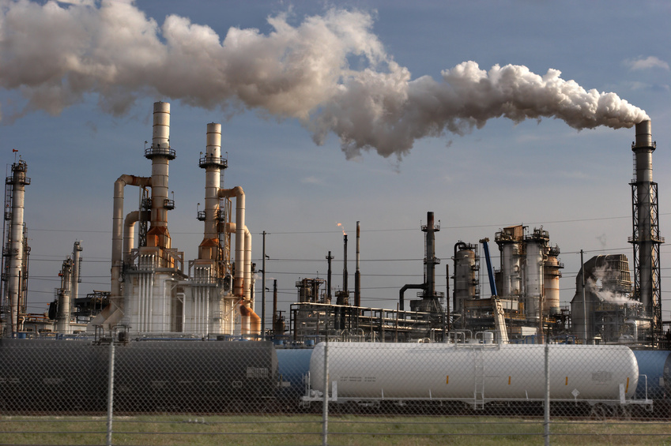
Think-Pair-Share
What would happen if a factory’s supplies never arrived?
What about if they couldn’t get rid of their garbage?
Notes:
Have a discussion about the importance of everything operating correctly and the flow of things in and out of a working factory.

Slide 5
Cells are like factories.
Both cells and factories need to get things in (nutrients) and out (wastes).
These things keep the cell healthy and able to divide.
What part of the cell controls the things that go in and out of the cell?
CELL MEMBRANE
Notes:
Cells dividing is what allows organisms to grow

Slide 6
Moving Small Particles
Small particles (like sugars) cross the cell membrane through passageways called channels
The channels are made of proteins
They pass through the channels by either active or passive transport

Slide 7
Passive Transport
Passive transport- the movement of substances across a cell membrane without the use of energy by the cell
Examples: diffusion and osmosis
Let’s see it!

Slide 8
Active transport
Active transport- the movement of substances across the cell membrane that requires the cell to use energy
Usually is particles moving from an area of low concentration to an area of high concentration
Or…low density to high density
Notes:
Refer back to the demo using students as desks for props. Ask them if it would take more energy to move to the lower density area or to scrunch yourself into the area of higher density.

Slide 9
Define Diffusion
The movement of molecules from an area in which they are highly concentrated to an area in which they are less concentrated.

Slide 10
Draw a diagram of an example of diffusion we saw in class.

Slide 11
Define osmosis
The diffusion of water across a selectively permeable membrane.

Slide 12
Define osmosis
Water moves from a high concentration of water (less salt or sugar dissolved in it) to a low concentration of water (more salt or sugar dissolved in it). This means that water would cross a selectively permeable membrane from a dilute solution (less dissolved in it) to a concentrated solution (more dissolved in it).

Slide 13
Define osmosis
In this picture a red blood cell is put in a glass of distilled water (all water with no salt or sugar in it). Because there is a higher concentration of water outside the cell, water enters the cell by OSMOSIS. In this case too much water enters and the cell swells to the point of bursting open. In the end pieces of cell membrane are left in the water.
http://www.usd.edu/~bgoodman/Osmos.htm

Slide 14
Define selectively permeable membrane
A membrane that allows only certain materials to cross it
Materials pass through pores in the membrane

Slide 15
Why are osmosis & diffusion important?

Slide 16
Why are osmosis & diffusion important?
All living things have certain requirements they must satisfy in order to remain alive – maintain homeostasis
These include exchanging gases (usually CO2 and O2), taking in water, minerals, and food, and eliminating wastes.
These tasks happen at the cellular level.
Molecules move through the cell membrane by diffusion

Slide 17
Moving Large Particles
Small particles cross the cell membrane by
Diffusion
Active transport
Passive transport
Large particles use the processes called endocytosis and exocytosis

Slide 18
Endocytosis
Endocytosis- the process by which a cell membrane surrounds a particle and encloses the particle in a vesicle to bring the particle into the cell
Vesicle- sacs formed from pieces of cell membrane
cell
PROTEIN

Slide 19
Exocytosis
Exocytosis- the process in which a cell releases a particle by enclosing the particle in a vesicle that then moves to the cell surface and fuses with the cell membrane
Things like wastes..EXIT (EXO) the cell

Slide 20
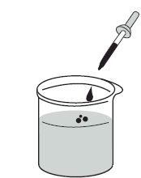
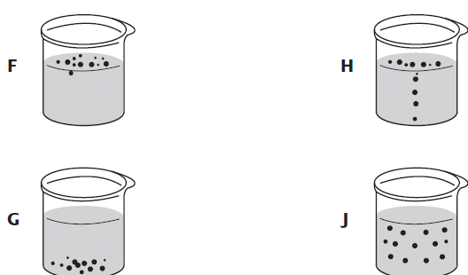
Closure
A student adds drops of dye to a beaker of room-temperature water, as shown in the diagram below. Which diagram best shows the end result of diffusion?

