Slide 1
Homeroom Warm Up 8/24/21
Dress for success" is a phrase all of us have heard before, but it means something different to each person. Write a paragraph explaining what "dress for success" means to you.

Slide 2
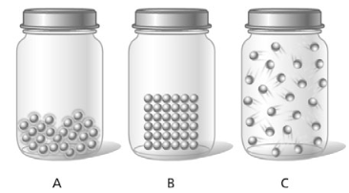
Science Warm Up 8/24/21
The following illustration shows three different states of a substance. Which of the following happens when the substance in jar B changes state to the substance in jar A?
A. The particles vibrate faster.
B. The mass of the substance increases.
C. The identity of the substance changes.
D. The particles expand to fill their container.

Slide 3
Science Warm Up 8/24/21
Dry ice is solid carbon dioxide. At room temperature, it changes directly into a gas. Which of the following describes this change?
Evaporation results in a reduction of the mass of carbon dioxide.
Freezing occurs due to a decrease in the kinetic energy of the particles.
Sublimation occurs due to an increase in the kinetic energy of the particles.
Deposition causes the particles of the carbon dioxide gas to lock into place.

Slide 4
Homework Due by 3PM on this Friday
2nd Period Code→ IPQJV
3rd Period Code→23XTP
4th Period Code→GA2DN
6th Period Code→ WBXN7
^{8th} Period Code→76TM4
Nearpod Lesson

Slide 6
PHASE CHANGES
Description of Phase Change | Term for Phase Change | Heat Movement During Phase Change
Solid to liquid | Melting | Heat goes into the solid as it melts.
Liquid to solid | Freezing | Heat leaves the liquid as it freezes.

Slide 7
PHASE CHANGES
Description of Phase Change | Term for Phase Change | Heat Movement During Phase Change
Liquid to gas | Vaporization, which includes boiling and evaporation | Heat goes into the liquid as it vaporizes.
Gas to liquid | Condensation | Heat leaves the gas as it condenses.
Solid to gas | Sublimation | Heat goes into the solid as it sublimates.

Slide 8
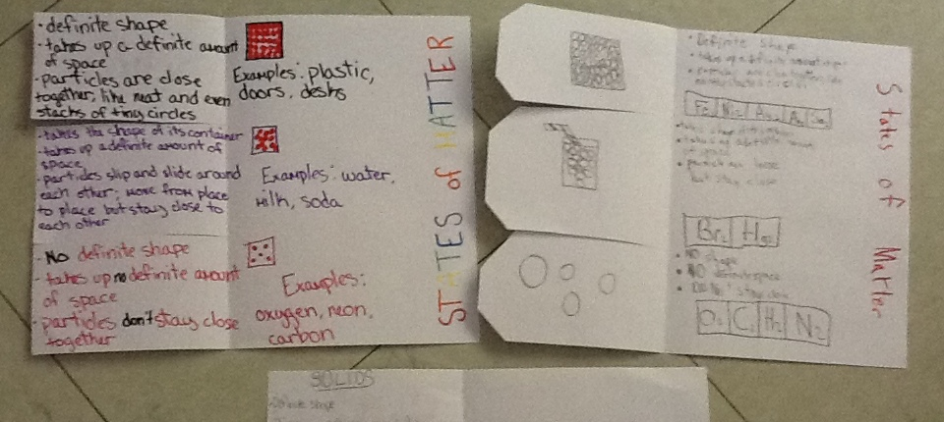
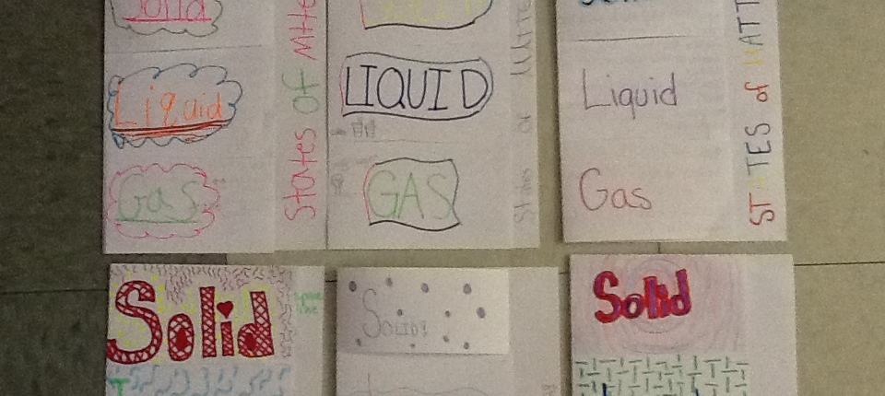
Assignment “States of Matter Foldable”
Must include
Solid, Liquids, Gas.
Definition/3 examples
Picture of particle arrangement
See examples →

Slide 9
States of Matter Foldable
The foldable we started on in class yesterday should be completed at this time and glued down inside of your Science notebook.

Slide 10
Science Closure 8/24/21
Which state of matter will take both the volume and shape of the container that holds it?
gas
ice
liquid
solid

