Slide 1
Homeroom Warm Up 2/28/2020
Describe someone who is a hero to you and explain why.

Slide 2
Science Warm Up 2/28/2020
Having a widow's peak (W) is dominant to not having a widow's peak (w). Determine the genotype percentage for the offspring of a homozygous dominant female and a homozygous recessive male.
a. 25% WW, 50% Ww, 25% ww
b. 75% Ww, 25% ww
c. 100% Ww
d. 50% WW, 50% ww

Slide 3
Take a look at the picture below. Now complete the following sentences with your own responses
1. This makes me think of….
2. I wonder….
3. I have some questions….
4. This makes me want to….

Slide 4
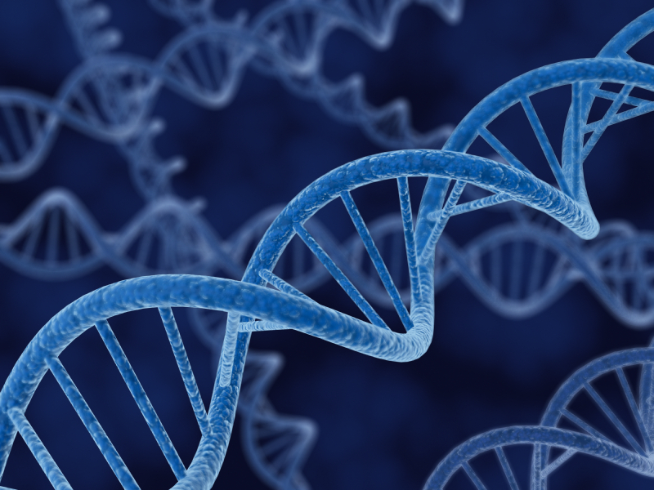
DNA Structure
Unwinding the Double Helix

Slide 5
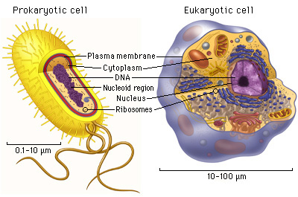
What we already know:
The nucleus contains DNA
Eukaryotes have linear DNA
Prokaryotes have circular DNA
DNA is copied during Interphase of the Cell Cycle

Slide 6
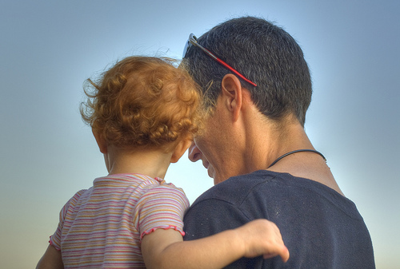
What we already know:
Traits are distinguishing features or characteristics
Traits are passed from parent to offspring
Traits are passed on through genes
Genes are specific sections of DNA
In sexual reproduction, offspring get half of their genes from each parent

Slide 7
DNA is INFORMATION
DNA= deoxyribose nucleic acid
A molecule that stores information
Contains the instructions for making proteins
Like a cookbook contains the instructions for making a cake

Slide 8
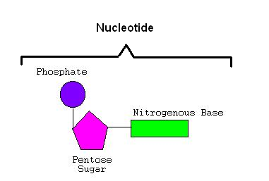
Structure of DNA
DNA is a long (about 2 meters!) chain of nucleotides held together with covalent bonds.
A nucleotide is the monomer of DNA.
It’s made up of three parts
Phosphorous
Sugar (deoxyribose in DNA)
Nitrogenous base

Slide 9
Structure of DNA
The phosphorous and deoxyribose sugar are the same for all nucleotides.
The nitrogenous base can be one of four.
There are four nitrogenous bases in DNA:
Adenine (A)
Thymine (T)
Guanine (G)
Cytosine (C)

Slide 10
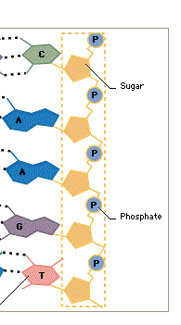
Structure of DNA
Phosphate group attaches to deoxyribose sugar with covalent bonds.
These are strong bonds
They make up the backbone of the DNA molecule.
The nitrogenous bases stick out from the deoxyribose sugars like steps.
Notes:
Anyone remember what covalent bonds are? Chemical bonds where the atoms share electrons. They’re pretty strong.

Slide 11
Nitrogenous Bases
But the nitrogenous bases are the most important part of DNA.
The order of the bases is a code for how to build proteins.
The exact order of all 3 billion bases in an organism’s genome is UNIQUE to that organism (unless it’s a clone or a twin.)

Slide 12
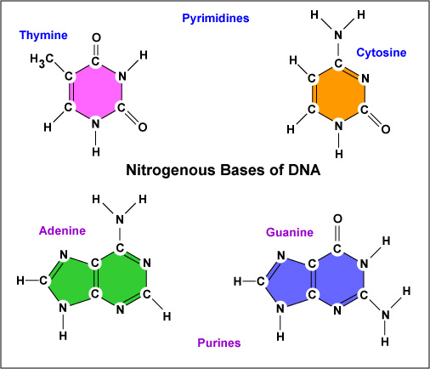
Nitrogenous Bases
This is what they look like (on a molecular level.)

Slide 13
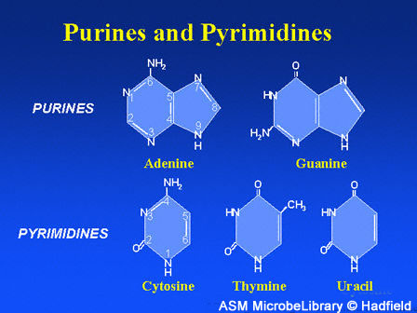
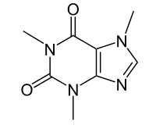
Nitrogenous Bases
Adenine and Guanine are called purines
Thymine and Cytosine are called pyrimidines
Fun fact: caffeine is
also a purine!

Slide 14
Nitrogenous Bases: Pairing
Adenine will form a hydrogen bond with Thymine
Guanine will form a hydrogen bond with Cytosine
This is called base pairing.
Where have we heard of hydrogen bonds before? Water molecules!
*Remember: h-bonds are fairly weak!

Slide 15
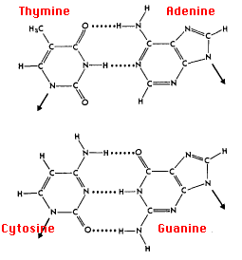
Nitrogenous Bases: Pairing
T-A forms two H-bonds
C-G forms three H-bonds

Slide 16
Chargraff’s Rule
Erwin Chargraff discovered that the percentage of T’s in any given organism’s DNA equals the percentage of A’s, and the percentage of G’s equals the percentage of C’s.
%A =% T
%G = %C

Slide 17
Applying Chargraff’s Rule
So…
If an organism’s genome is 30% T’s, what are the percentages of the other three bases?
If a different organism’s genome is 15% C’s, what are the percentages of the other three bases?

Slide 18
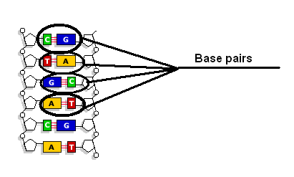
Chargraff’s Rule
The fact that A always bonds with T and C always bonds with G is the rule of base pairing.

Slide 19
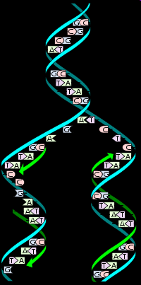
Base Pair Bonding
Why is it important that base pair bonds are weak?
So the DNA molecule can break apart!
But that’s another story…
…but we’ll talk about that tomorrow…

Slide 20
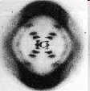
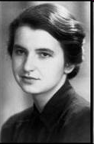
Structure of DNA
What does DNA look like?
Rosalind Franklin took an x-ray diffraction picture of a DNA strand from the top down. It looked like this:

Slide 21
Structure of DNA
From Franklin’s picture, Watson and Crick were able to figure out that DNA looks like a double helix.
This double helix shape looks like a twisted ladder.
The phosphates and deoxyribose sugars form the sides. The nitrogenous bases form the ladder rungs.

Slide 22
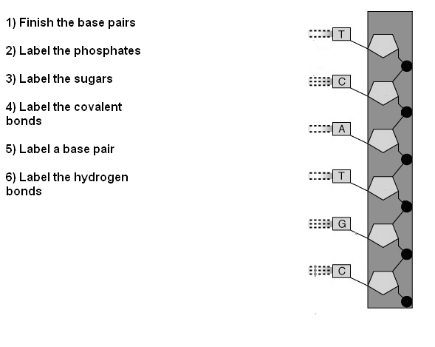
Exit Ticket!

