Slide 1
Science Warm Up 12/4/2020
What coefficients will balance the skeletal equation below?
___N₂ +____ O₂ → ______NO₂
A. 2, 2, 3
B. 1, 2, 2
C. 3, 2, 1
D. 1, 2, 1

Slide 2
Agenda
Warm Up
Review Objective
Intro to Cells part 2 notes
Match Me Activity
Closure

Slide 3
to create
A miniature representation of something
to make
to determine
SWBAT develop and construct models of cells IOT identify and explain the structure and function of major cell organelles as they contribute to life activities of the cell and organism.
to make clear
One of the small bodies in a cell’s cytoplasm
The arrangement of parts in an Organism
The special activity of a part.
A living thing.
to give

Slide 4
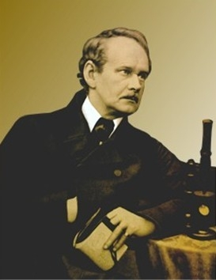
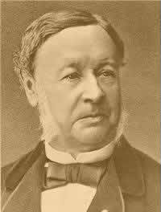
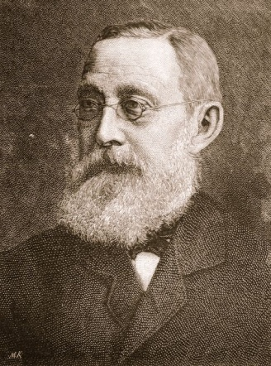
The Cell Theory
Who developed the cell theory?
Matthias Schleiden (1838): concluded that all plants are composed of cells
Theodor Schwann (1839): concluded that all animals are composed of cells
Rudolph Virchow (1855): determined that cells come only from other cells

Slide 5
Cell Diversity
Size
Shape
Internal Organization

Slide 6
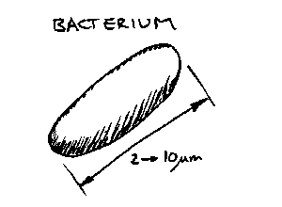
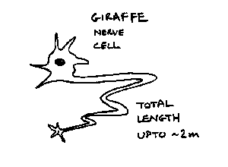
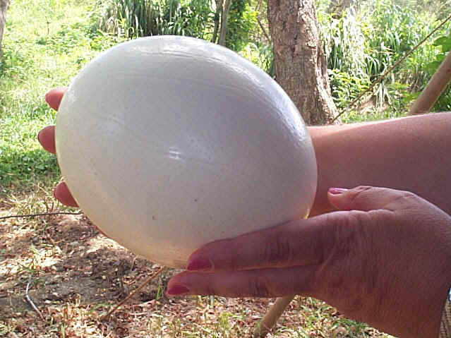
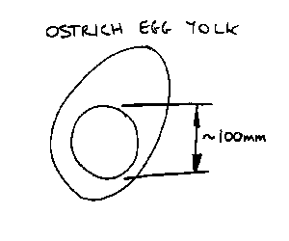
Cell Diversity- Size
Smallest Cells:
Biggest Cells:
Longest Cells:
6 inches long, 5 inches wide, 3 pounds
Ostrich Egg

Slide 7
Two Types of Cells
Prokaryotic
Eukaryotic

Slide 8
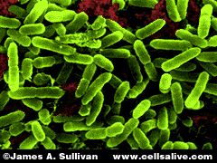
Prokaryotic Cells
Do not have structures surrounded by membranes
Few internal structures
One-celled organisms, Bacteria
http://library.thinkquest.org/C004535/prokaryotic_cells.html

Slide 9
Eukaryotic
Contain organelles surrounded by membranes
Most living organisms
Plant
Animal
http://library.thinkquest.org/C004535/eukaryotic_cells.html

Slide 10
“Typical” Animal Cell
http://web.jjay.cuny.edu/~acarpi/NSC/images/cell.gif

Slide 11
“Typical” Plant Cell
http://waynesword.palomar.edu/images/plant3.gif

Slide 13
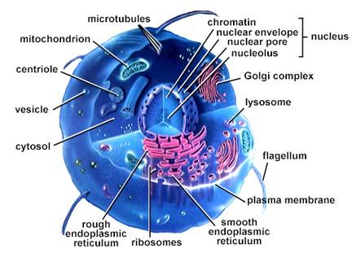
The Parts of the Cell
Each living cell carries out the tasks of taking food, transforming food into energy, getting rid of wastes, and reproducing.

Slide 14
Cell Parts
Organelles

Slide 15
Surrounding the Cell

Slide 16
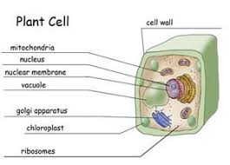
Cell Membrane
Outer membrane of cell that controls movement in and out of the cell
Selectively permeable
Found in all cells
Cell Wall
Most commonly found in plant cells & bacteria
Supports & protects cells

Slide 17
Inside the Cell

Slide 18
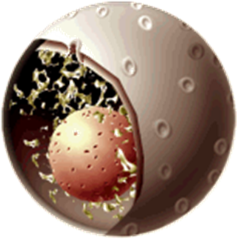
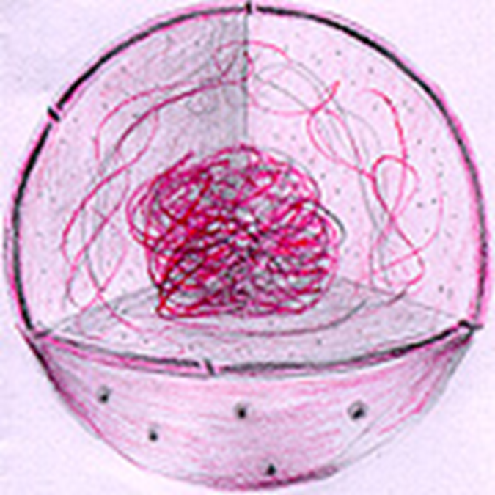
Nucleus
Nucleolus
controls cell activities
Contains genetic material - DNA
Inside nucleus
Contains RNA to build proteins

Slide 19
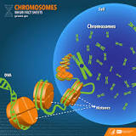
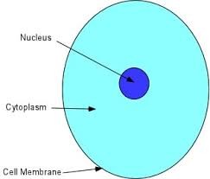
CHROMOSOMES
CYTOPLASM
In nucleus
Made of DNA
Contain instructions for traits & characteristics
Gel-like mixture that holds everything in place.

Slide 20
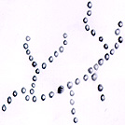
MITOCHONDRIA
RIBOSOMES
Makes proteins
Found on ER or floating throughout cell
Provide energy for the cell
Site of cellular respiration
Known as the power house of the cell

Slide 21
Endoplasmic reticulum
Intercellular highway (a path along which molecules move from one part of the cell to another)
Smooth ER: lacks ribosomes
Rough ER (pictured): ribosomes embedded in surface

Slide 22
Golgi Bodies
Protein 'packaging plant‘ of the cell
Move materials out of the cell
http://library.thinkquest.org/12413/structures.html

Slide 23
Lysosome
Function: breaks down food particles, invading objects, or worn out cell parts
http://library.thinkquest.org/12413/structures.html

Slide 24
Vacuoles
Function: used for STORAGE of wastes, nutrients, and water
http://library.thinkquest.org/12413/structures.html

Slide 25
Chloroplast
found in plant cells
Contains green chlorophyll
Site of photosynthesis
http://library.thinkquest.org/12413/structures.html

Slide 26
MATCH ME
Ribosomes
Mitochondria
Golgi Body
Lysosomes
Vacuole
A. Packaging center for the cell
B. Breaks down unwanted waste
C. Provides energy for the cell
D. Stores water, nutrients, and other items
E. Makes proteins

Slide 27
Science Closure 12/4/2020
Which of the following statements are true?
(Select all that apply.)
The nucleus controls the activities of the cell.
The vacuole is the site of cellular respiration.
The cell wall controls what goes in and comes out of the cell.
The golgi body is the packing center of the cell.

