Slide 1
Agenda
Warm Up
Phenomena
Overview of Objective
Define Weekly Vocabulary Terms
Video & notes

Slide 2
Take a look at the picture below and complete the following sentences with your own responses
1. This makes me think of….
2. I wonder….
3. I have some questions….
4. This makes me want to….

Slide 3
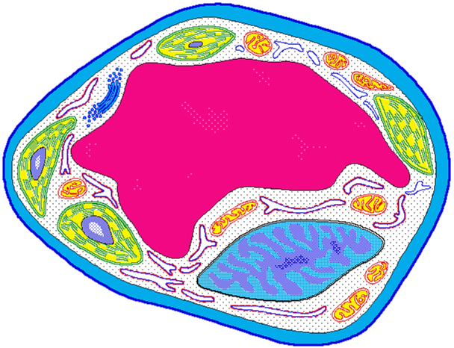
Cell Structure & Function

Slide 4
to create
A miniature representation of something
to make
to determine
SWBAT develop and construct models of cells IOT identify and explain the structure and function of major cell organelles as they contribute to life activities of the cell and organism.
to make clear
One of the small bodies in a cell’s cytoplasm
The arrangement of parts in an Organism
The special activity of a part.
A living thing.
to give

Slide 5
Unit Vocabulary Terms
Cell
Organism
Cell Membrane
Cytoplasm
Organelle
Nucleus
Prokaryote
Eukaryote
Homework→ Read Science textbook pages 145-153 and define all vocabulary terms.

Slide 6
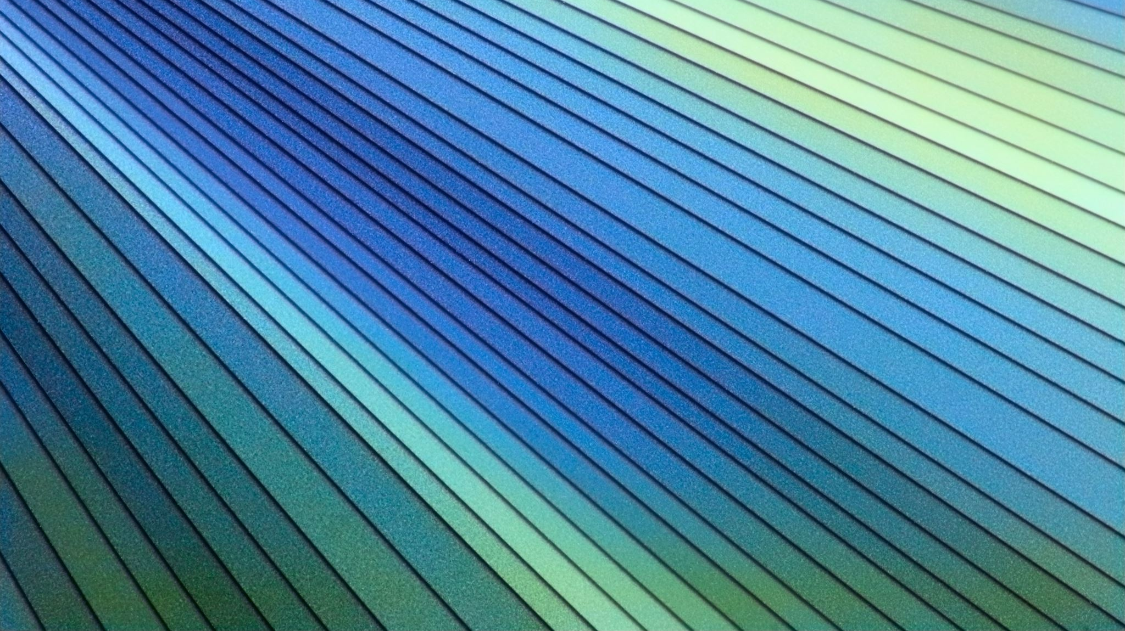
Word Wall
Cell-the smallest unit that can perform all life’s processes.
Organism-anything that can carry out life processes independently.
Cell Membrane- a layer that covers a cell and acts as a barrier between the inside of a cell and the cell’s environment.
Cytoplasm- the region inside the cell that includes the fluid.
Organelle- one of the small bodies in a cell’s cytoplasm that are specialized to perform a specific function.
Nucleus- a membrane bound organelle that contains the cell’s DNA and controls the cell’s activities.
Prokaryote- A single celled organism that does not have a nucleus or membrane bound organelles.
Eukaryote- An organism made up of cells that have a nucleus enclosed by a membrane.

Slide 7
Definition of Cell
A cell is the smallest unit that is capable of performing life functions.

Slide 8
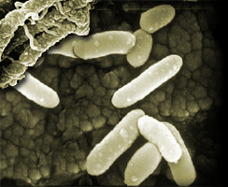
Examples of Cells
Amoeba Proteus
Plant Stem
Bacteria
Red Blood Cell
Nerve Cell

Slide 9
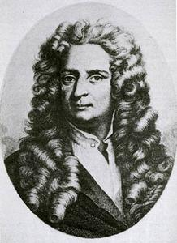
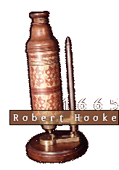
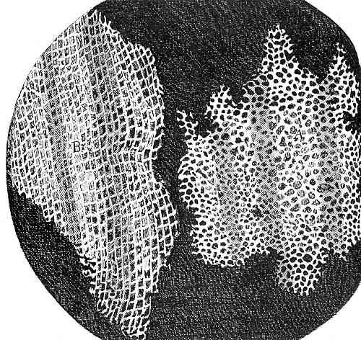
Discovery of Cells
The invention of the lens
Robert Hooke (1665): observed a thin slice of cork (dead plant cells) with a microscope. He described what he observed as “little boxes” (cells).

Slide 10
The Cell Theory
1. All living things are composed of one or more cells.
2. Cells are organisms’ basic units of structure and function.
3. Cells come only from existing cells.

