Slide 1
Warm Up 2/26/19

Slide 2
Warm Up

Slide 3
Science Warm Up 2/26/19
Which of these lists presents the stages of the cell cycle in the correct order?
interphase, mitosis, cytokinesis
cytokinesis, mitosis, interphase
mitosis, interphase, cytokinesis
interphase, cytokinesis, mitosis

Slide 4
1-2-3 It’s as easy as your Pedigree!

Slide 5
Pedigree’s
Pedigrees are a generational “map” that studies traits from parents to offspring. Many traits can be studied by mapping the trait from generation to generation.
There are specific symbols we use when making a pedigree.
Circles are females and squares are males.
Individuals affected by the trait being studied are colored in.
Lines are used to determine sibling relationship and other lines are used to attach mates.
A carrier or heteozygous individual only has half of its circle or square shaded in.
Take a look at all the symbols on the following slide.

Slide 6
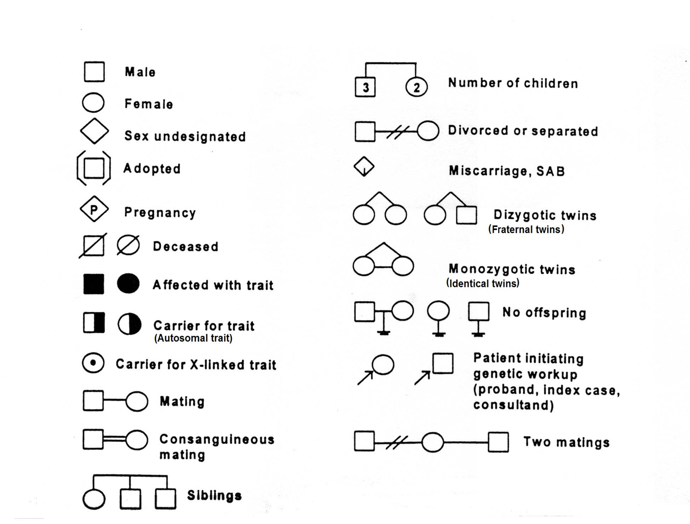
Interesting Symbols

Slide 7
Notice Everything you need to do when constructing a pedigree.
Brainstorm a list and then be ready to discuss all the things you spotted that you would need to do to complete a pedigree.

Slide 8
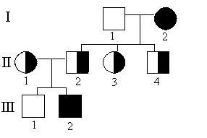
Pedigree Basics
Use Roman Numeralsto the left for each generation. (I, II, III, IV, V…..)
Number all the individuals beginning with the eldest as 1 on the far right and continue even with the marriages in each generation. (1,2,3,4,5,6…..)
Use a Roman Number and a number(digit) to define the family member. The male on the top right is labeled I-1

Slide 9
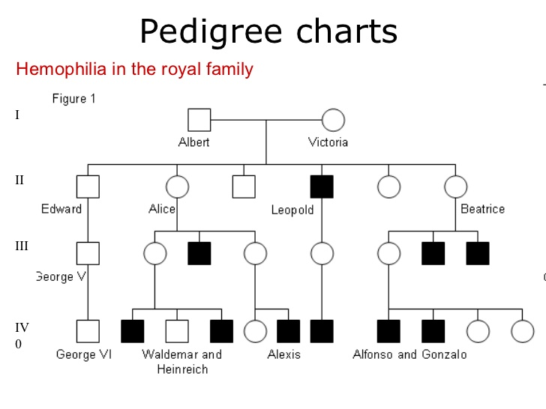
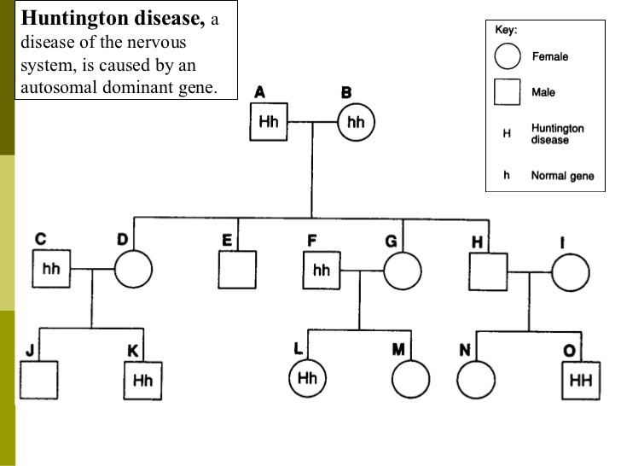
A Pedigree can determine genetic disorders.
You can be the detective and determine some genetic disorders by building a Pedigree. For example, pedigrees can be analyzed to determine the source of transmission for a genetic disease: Is the trait dominant or recessive? Are the disease alleles sex linked (X or Y) or autosomal(body cells)?

Slide 10
You Try It
How many individuals are heterozygous in generation II?
Is any one married in generation II?
Answer: 4
Answer: yes, II-1 to II-2

Slide 11
Try it!
How many generations are their?
Answer: 5
What individuals are affected?
Answer: II-1,V-1

Slide 12
Science Closure 2/26/19
Which of the following statements about pedigrees is true?
A. Boxes typically represent males and circles typically represent females.
B. Pedigrees can only be used to trace the occurrence of dominant traits.
C. Shaded shapes typically represent people who do not have a specific trait.
D. Pedigrees show all of the allele combinations that are possible in a cross.

